Slide 1
Books for Oliver
Day 1
Come to the Gathering Spot.
Please bring a pencil.

Slide 2
What is Shared Reading
Short Lessons
15 minutes (set the timer)
We read together
We spend 3 days on a story

Slide 3
Our First Story – Books for Oliver
Objectives
The learner will preview a text in order to make a prediction before reading. The learner will activate prior knowledge.
I will work with a partner to make a prediction about the story Books for Oliver. I will discuss what I know about Africa with my partner.

Slide 4
Preview a Text
CAFÉ strategies before reading
Activate Prior Knowledge Before Reading a Text
Make and Adjust Predictions (new!)

Slide 5
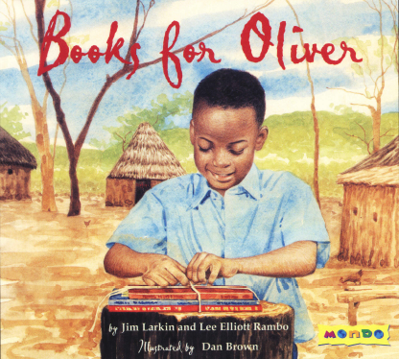
Make Predictions Prior to Reading
After looking at the cover of this book and reading the title, talk with a partner. What do you think this book will be about?
This is called a prediction.
Write your prediction on a notecard.

Slide 6
Activate Prior Knowledge about a Text
Read the blurb
Think about your prior knowledge regarding this topic.
The selection tells the story of Oliver Kipmutai, a young boy who lives on a farm in the Kenyan Highlands in Africa. He loves being in school as well as helping his father on the farm. As the story opens, Oliver is discussing with his parents how he will obtain his books for school, since where he lives, children are responsible for supplying their own schoolbooks.
What are the topics in this blurb?
Turn and Talk: What do you know about Africa? Schoolbooks? Farms?

Slide 7
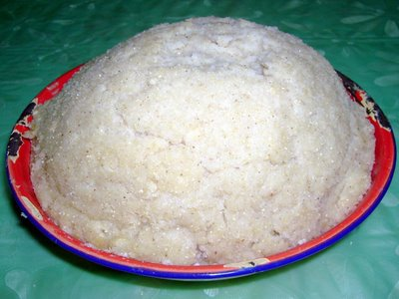
Preview Vocabulary
Ugali – a kind of hot cereal

Slide 8
Read the Story
Read with me if you’d like.

Slide 9
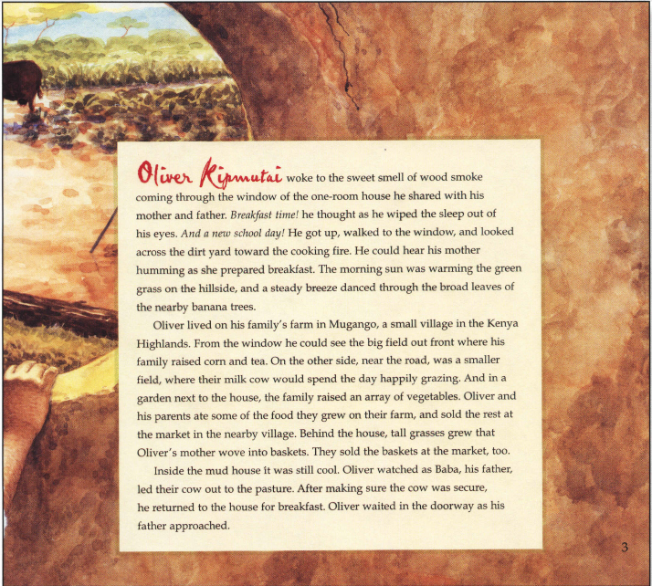

Slide 10
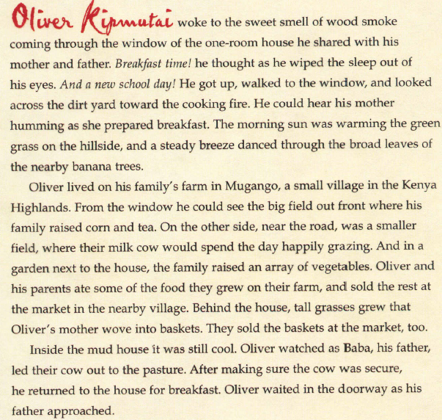

Slide 11
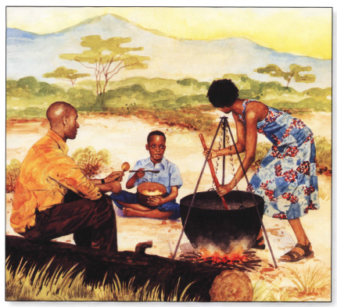

Slide 12
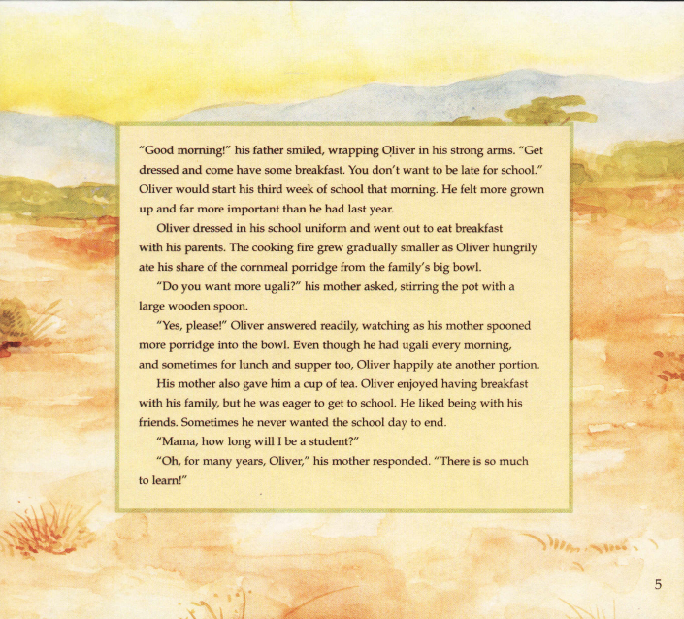

Slide 13
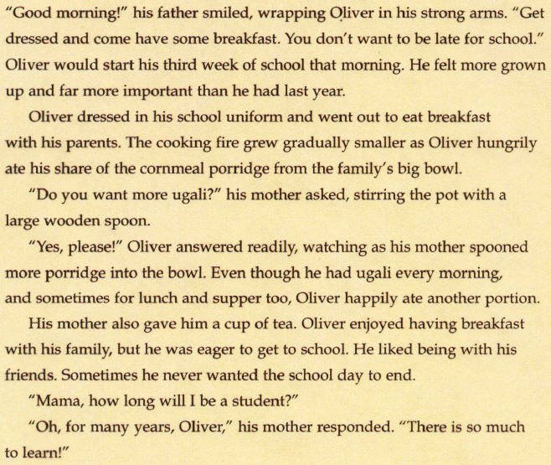

Slide 14
Confirming Your Predictions
As we read, we also think if our predictions were right or need to be adjusted.
Look at your predictions your wrote. Were they correct? If they weren’t, that’s OK!!!! You make a new prediction.

Slide 15
That’s all…Did we finish in 15 mins?
Objectives
The learner will preview a text in order to make a prediction before reading. The learner will activate prior knowledge.
I will work with a partner to make a prediction about the story Books for Oliver. I will discuss what I know about Africa with my partner.

Slide 16
Books for oliver
Day 2
Bring a pencil to the gathering spot, please.

Slide 17
Shared Reading
Remember, Shared Reading is:
Part of MONDO
15 Minutes Long
A chance for all of us to read together
A lesson about how to be a better reader
A story that we read for 3 days

Slide 18
Objectives
The learner will identify the main idea in the next part of Books for Oliver.
I will discuss with my partner what we thought was the main idea of the newest pages in Books for Oliver. Together, we will write the main idea on a notecard. We will read aloud what some people wrote as the main idea.

Slide 19
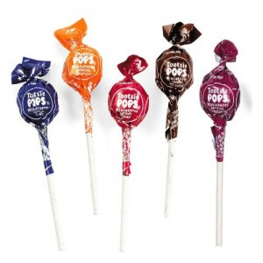
Strategy: Main Idea
When we find the main idea of a text, we ask ourselves “what’s the heart of this story,” or “what’s mostly happening in this story.”
Think of it like this: When I eat a Tootsie Pop, I really just want to get to the Tootsie Roll Center because it’s the heart of the tootsie pop, or what the tootsie pop is mostly about. The coating around the Tootsie Roll is also good and adds more to the Tootsie Pop, but main part is the Tootsie Roll.

Slide 20
Practice with Main Idea
We can practice finding the main idea of a text by finding the main idea of Books for Oliver that we’ve read so far.
Think, Pair, Share - What was the main idea so far in Books for Oliver?
You’re asking yourself “what was the story mostly about so far?” or “what was the heart of the story so far?”
You’re not telling yourself all of the details, even though they’re nice to remember, you’re just remembering the Tootsie Roll center…
Look back at the story…

Slide 21
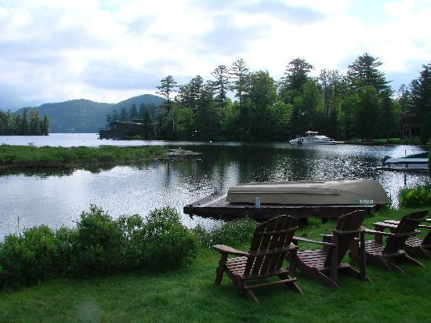
New Vocabulary
Placidly
The cows mooed placidly in the field.
This means peacefully or happily.

Slide 22
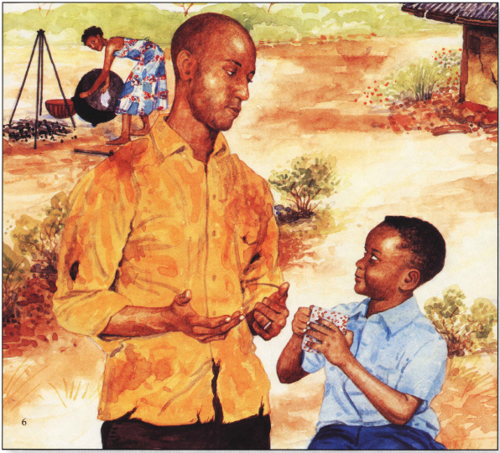
Continue Reading the Story

Slide 23
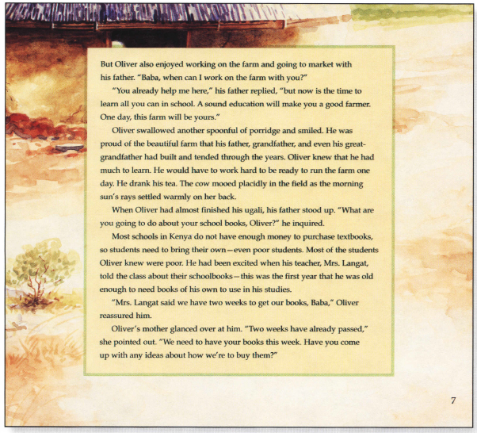

Slide 24
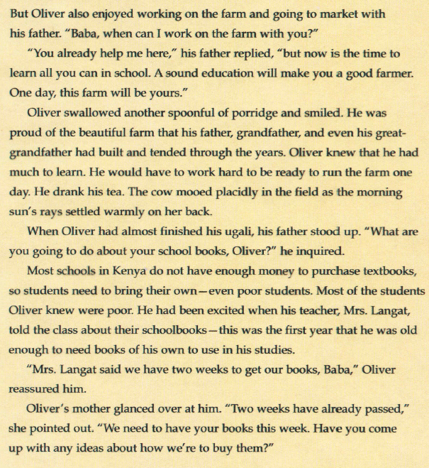

Slide 25
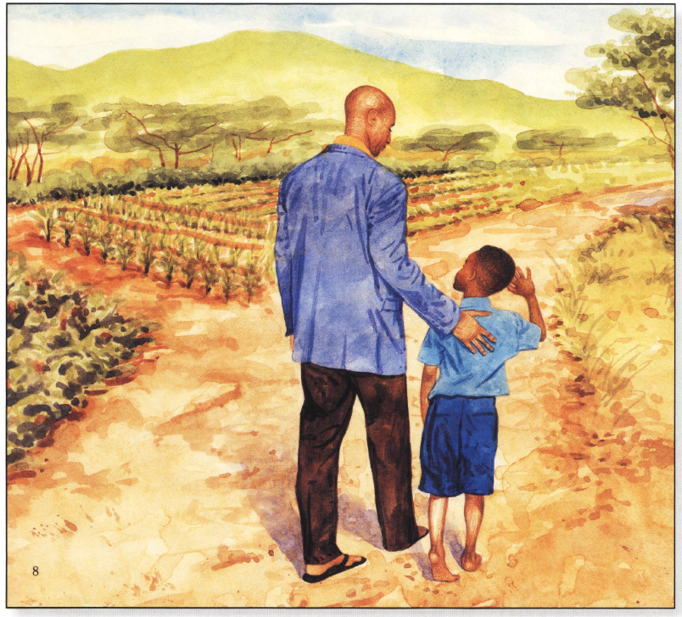

Slide 26
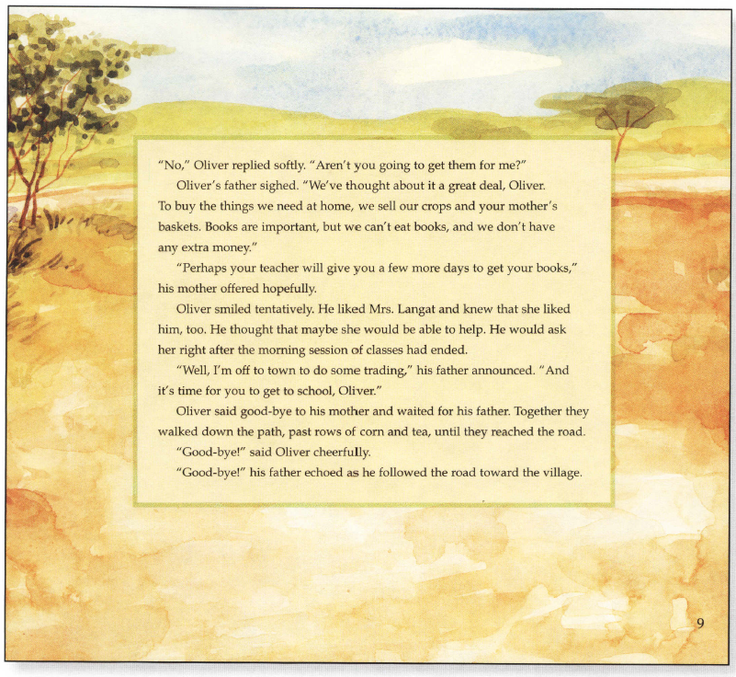

Slide 27
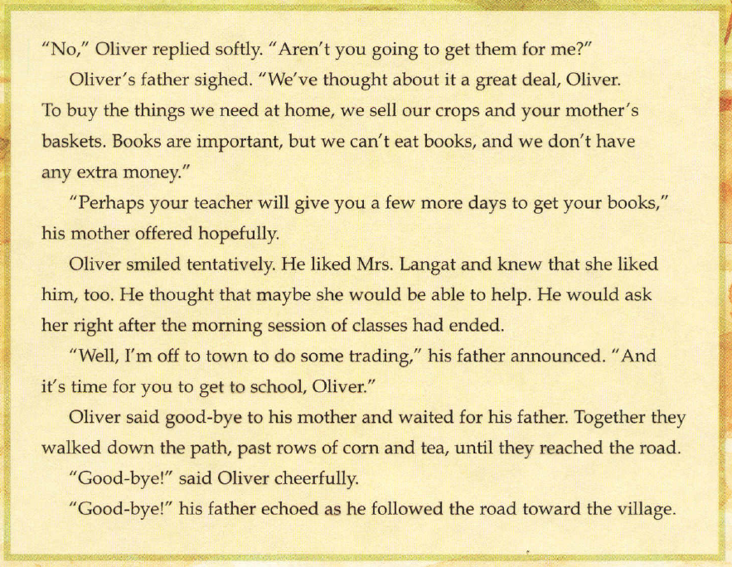

Slide 28
Main Idea
Now ask yourself “what was the main idea of the second part of the story.”
Work with a partner and write it on a notecard. You’ll hand these in and someone else will read it, so write nicely. No names on it.
Pass them in to me.
I’ll redistribute them.
Everyone will read a notecard aloud.

Slide 29
Review
Did we complete our objectives?
The learner will identify the main idea in the next part of Books for Oliver.
I will discuss with my partner what we thought was the main idea of the newest pages in Books for Oliver. Together, we will write the main idea on a notecard. We will read aloud what some people wrote as the main idea.

Slide 30
Books for Oliver
Day 3
Come to the Gathering Spot. Bring a SMILE.

Slide 31
Shared Reading
Remember, Shared Reading is:
Part of MONDO
15 Minutes Long
A chance for all of us to read together
A lesson about how to be a better reader
A story that we read for 3 days

Slide 32
Objectives
The learner will make a connection with the text Books for Oliver in order to understand how the characters feel.
I will think of an experience that I’ve had which is similar to Oliver’s. I will explain this connection to my partner. I will then explain how this connection helps me make a prediction.

Slide 33
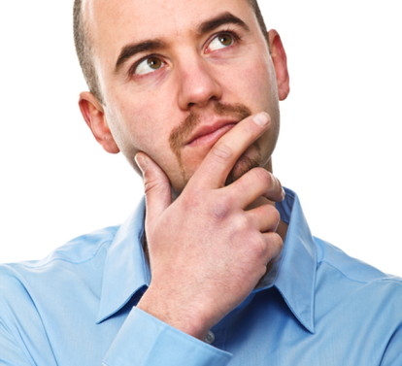
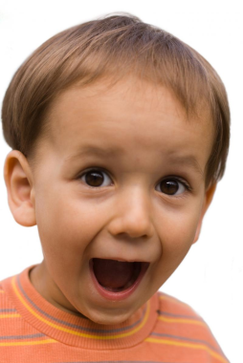
Strategy: Make a Connection with the Text
As we read a story, it’s important to make connections with the text. You can think of a time when you have felt the same way as the character.
Then, once you understand how the character feels, you might be able to make a prediction about what you think the character will do next.
Can I make a connection with a character? Have I ever felt that way?
If I connect with a character, I can make a prediction!

Slide 34
Review
What is the main idea of Books of Oliver?
What is the heart of the story?
Not details, THE HEART – What’s MOSTLY happening.

Slide 35
Make a Connection
Have you ever been unable to have or do something really important?
My example.
Think, Pair, Share

Slide 36
Make a Prediction
Our brains need to be constantly working when we are reading.
Your brain should be
Tuning in to interesting vocabulary
Making Inferences
Making connections
Predicting
Checking for Understanding
Monitoring and Fixing Up
If you made a connection with Oliver, please make a prediction about what you think he will do next. Turn and Talk
Use the sentence starter: “I have felt the way that Oliver feels, so I think he is going to ____________.”

