Slide 1
The American Revolution
Day 4

Slide 2
Housekeeping Announcements
Good Grade Challenge – Thursday
Choral-Fest – Wednesday
Future Fair – Friday
Computer Turn-In: May 28
MCA Balloon Day: May 29
Dodgeball: June 2 and 3
Assessments
Behavior
PBIS Snack: June 3

Slide 3
Review
Last Week, we learned about the Second Continental Congress.
With your STEAM Partner…
What was the 2nd CC?
What were the two outcomes of the 2nd CC?
What are the two reasons the battles of Lexington and Concord were important?
Keywords: Hope, Start

Slide 4
Today
We’ll learn about the Thomas Paine’s Common Sense
We’ll learn about the Declaration of Independence
We’ll get project work time.
Objectives:
The learner will summarize the purpose and parts of the Declaration of Independence. The learner will summarize how Thomas Paine influenced the colonies.
I will listen to Mr. Button as he talks about Common Sense and the Declaration of Independence
I will be able to tell my partner these questions.
How did Thomas Paine’s pamphlet Common Sense influence the colonists?
What was the purpose of the Declaration of Independence?

Slide 5
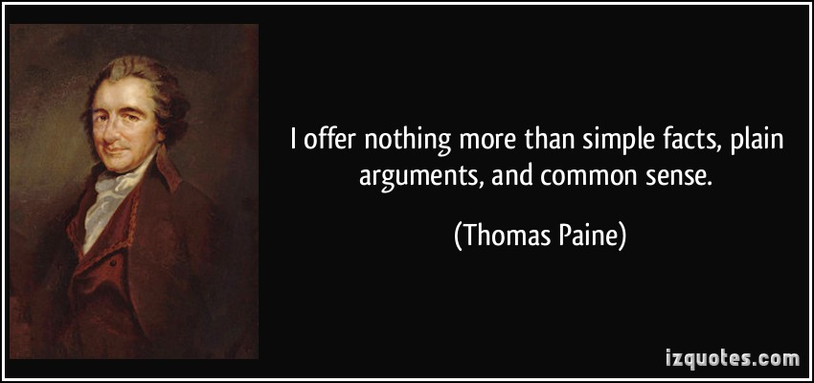
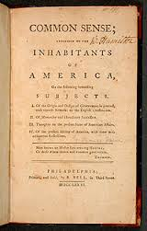
Thomas Paine writes “Common Sense”
Many colonists still believed that they should stay loyal to England.
To convince people to want to separate from England, Thomas Paine wrote “Common Sense,” which laid out in simple terms why the colonies should be their own country.
He said colonies get nothing from England.

Slide 6
Declaration of Independence
Declaration: To declare (say) something
Independence: To be able to make your own decisions
Declaration of Independence: a document sent to England announcing that they officially want to “break up” and become their own country.
Three Parts:
1: The Rights of all humans
2: A list of things that England has done to the colonists
3: Formal statement of Independence “We are our own country.”

Slide 7
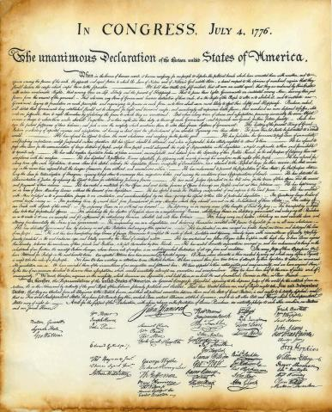
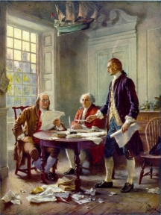
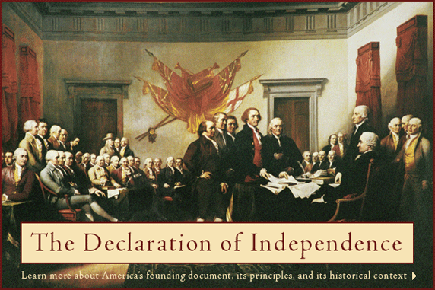
Declaration of Independence
The Declaration of Independence was signed on July 4, 1776.

Slide 8
Brain Break?

Slide 9
Recap
With your SPARK Partner:
How did Thomas Paine’s pamphlet Common Sense influence the colonists?
What was the purpose of the Declaration of Independence?

Slide 10
Projects
American Revolution Timeline Projects.docx

