Slide 1
The American Revolution
Day 5

Slide 2
Housekeeping Announcements
Good Grade Challenge – Thursday
Friday – TEST
First half of the AR
Study Guides
Choral-Fest – Wednesday
Future Fair – Friday
Computer Turn-In: May 28
MCA Balloon Day: May 29
Dodgeball: June 2 and 3
Assessments
Behavior
PBIS Snack: June 3

Slide 3
Review
Yesterday, we talked about the Declaration of Independence
With your STEAM Partner…
Who wrote the Declaration of Independence? Who was it sent to?
What was the purpose of the Declaration of Independence?
What did Thomas Paine do? (this is not in your notes)

Slide 4
Background

Slide 5
Today
We’ll learn about the Battle of Bunker Hill.
We’ll get project work time.
Objectives:
The learner will hear a summary of Bunker Hill.
I will listen to Mr. Button as he talks about the Battle of Bunker Hill.
I will be able to tell my partner these questions:
What was the outcome of the Battle of Bunker Hill?
Who said the phrase “don’t fire until you see the whites of their eyes?” Why?

Slide 6
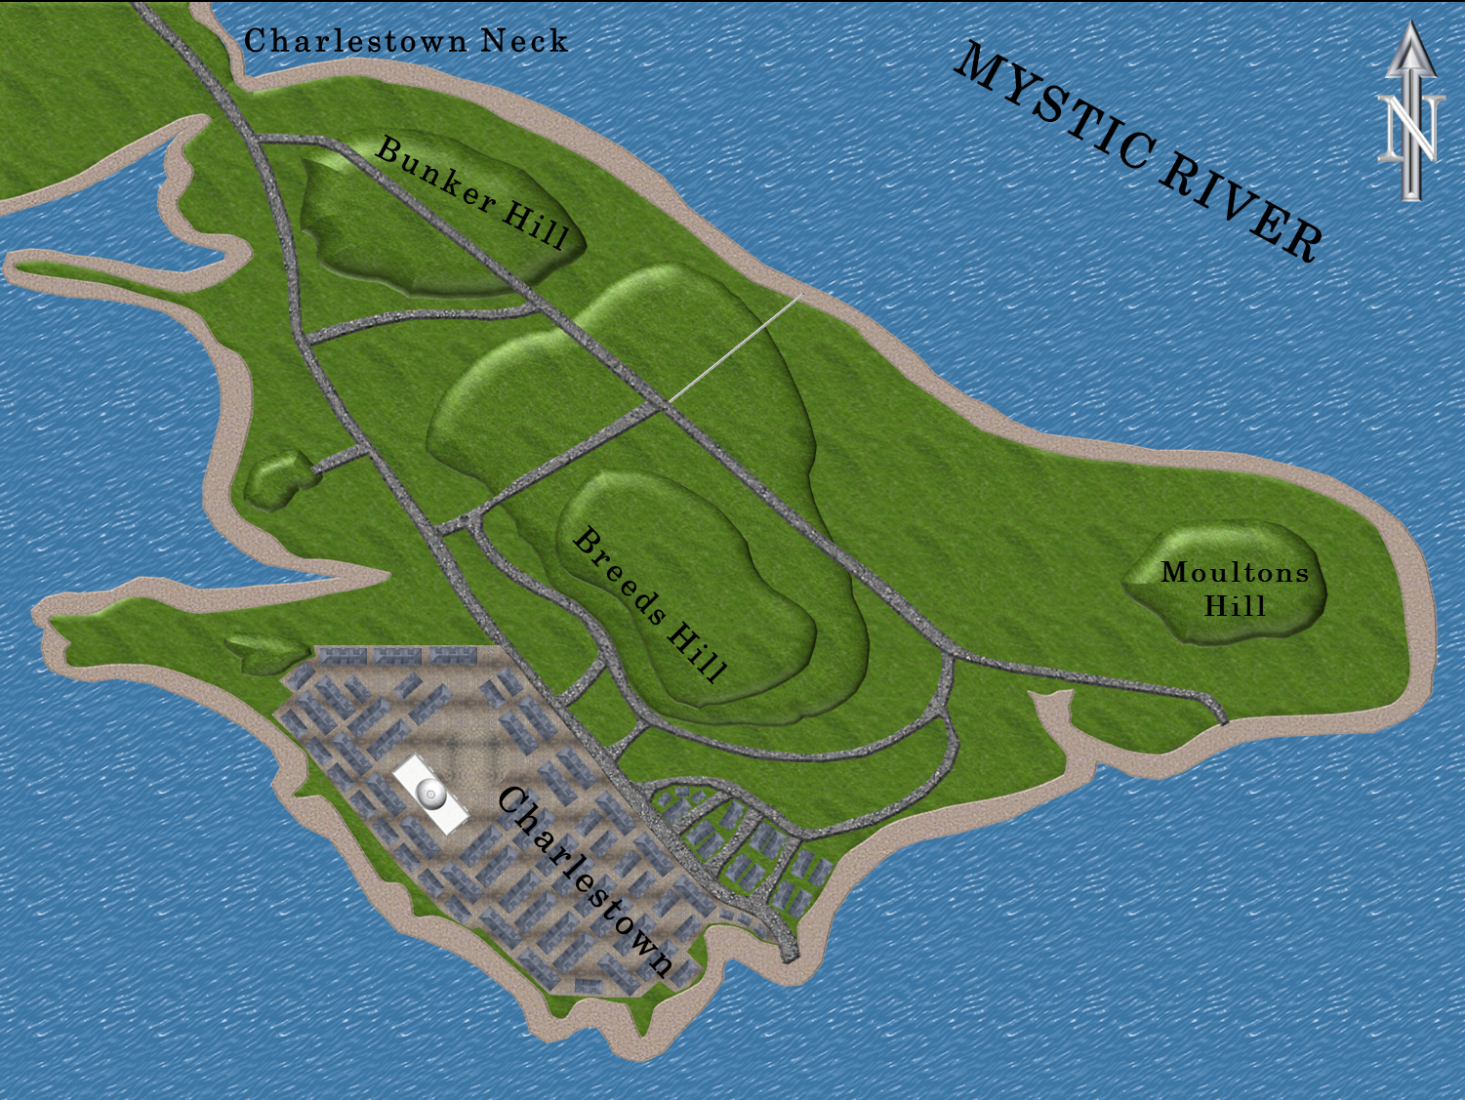
The Battle of Bunker Hill – Background
Bunker Hill (and Breed’s Hill) are near Boston.
British Commander William Howe wanted to capture Bunker Hill to gain full control of Boston Harbor.

Slide 7
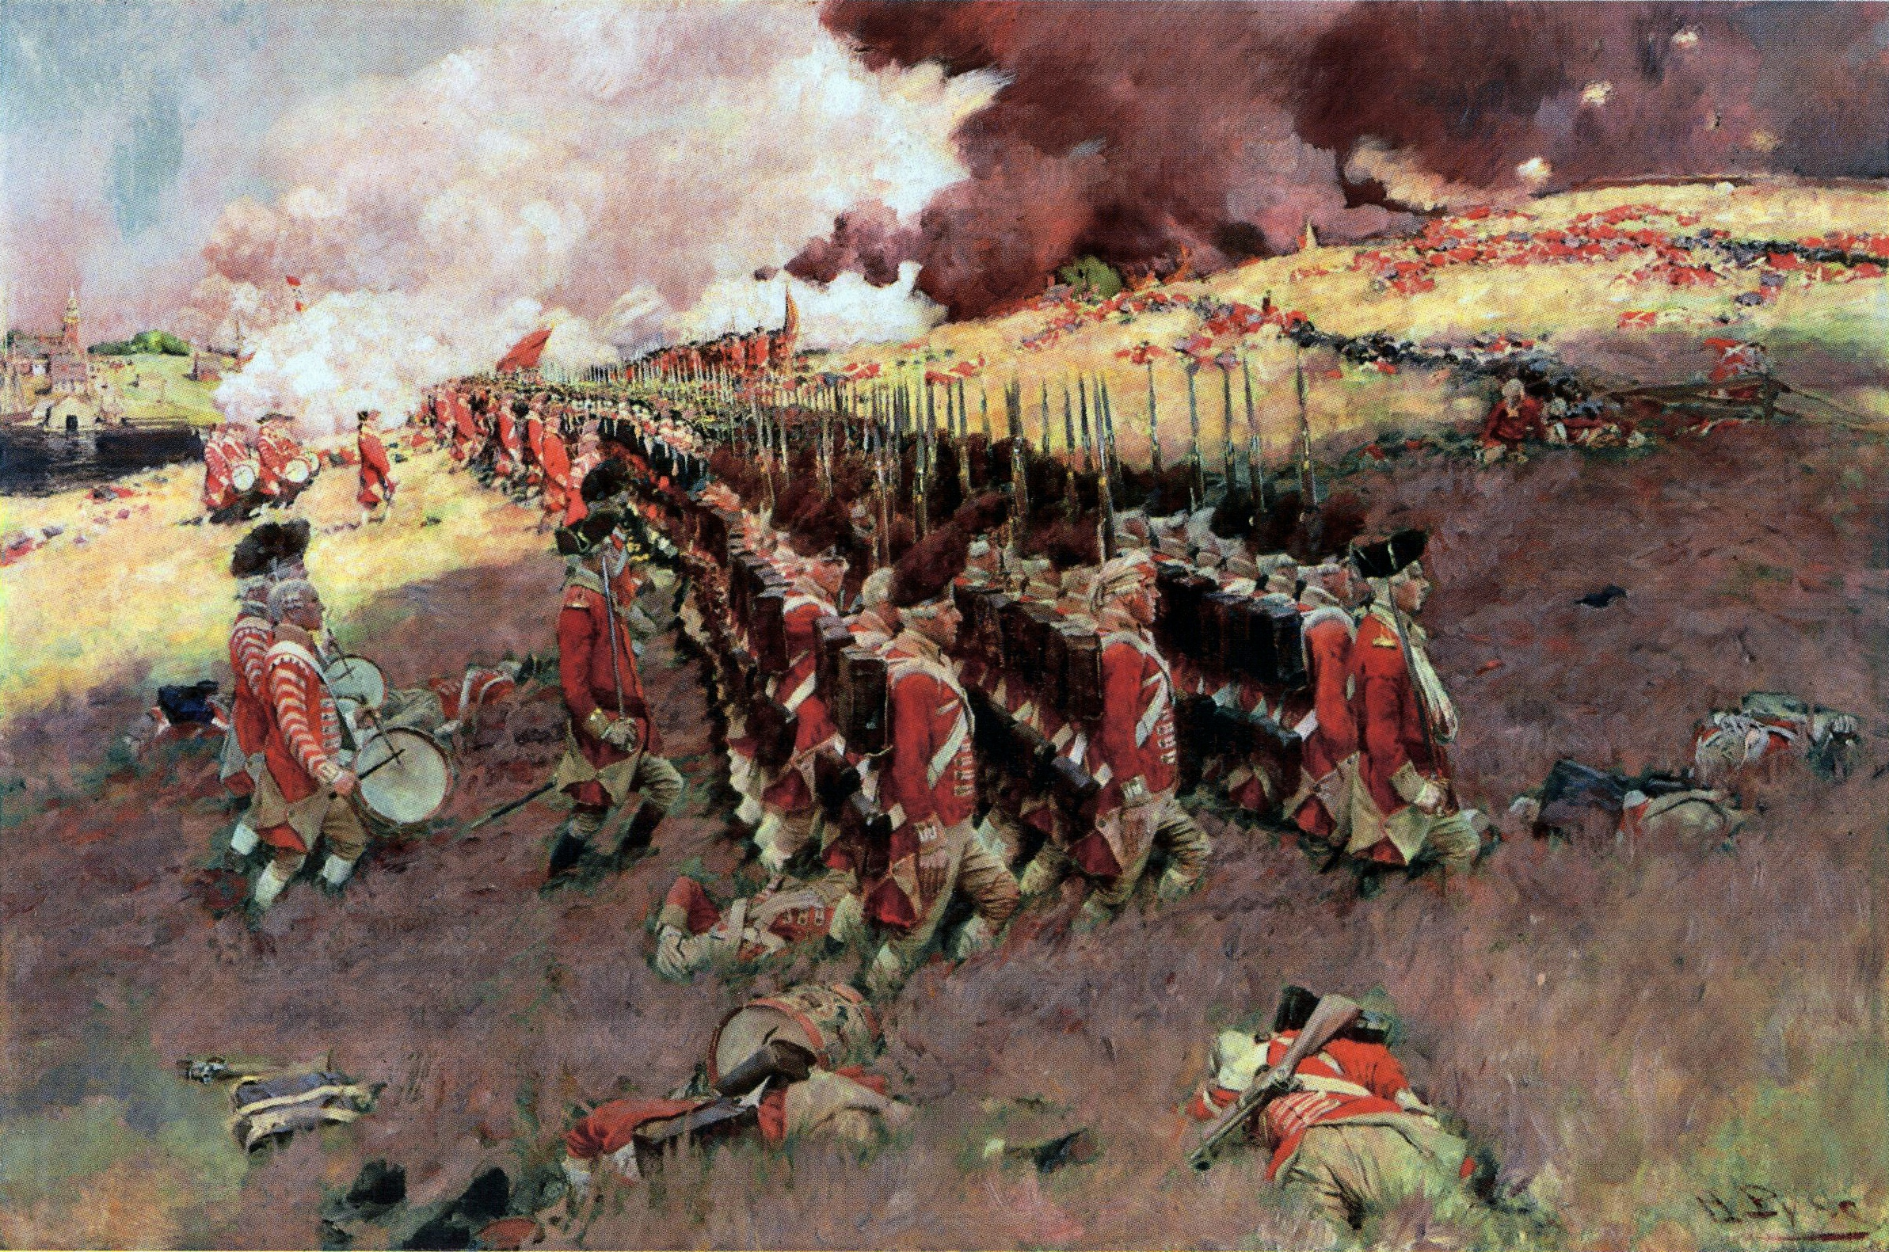
Battle of Bunker Hill – Colonists Strategy
But, the night before, colonial forces built earthworks (giant mounds of dirt) at the top of Breed’s Hill.
This protected the colonists as British soldiers marched up the hill.
At first, the colonists were winning. It was easy to shoot the redcoats walking in straight lines up a hill.

Slide 8
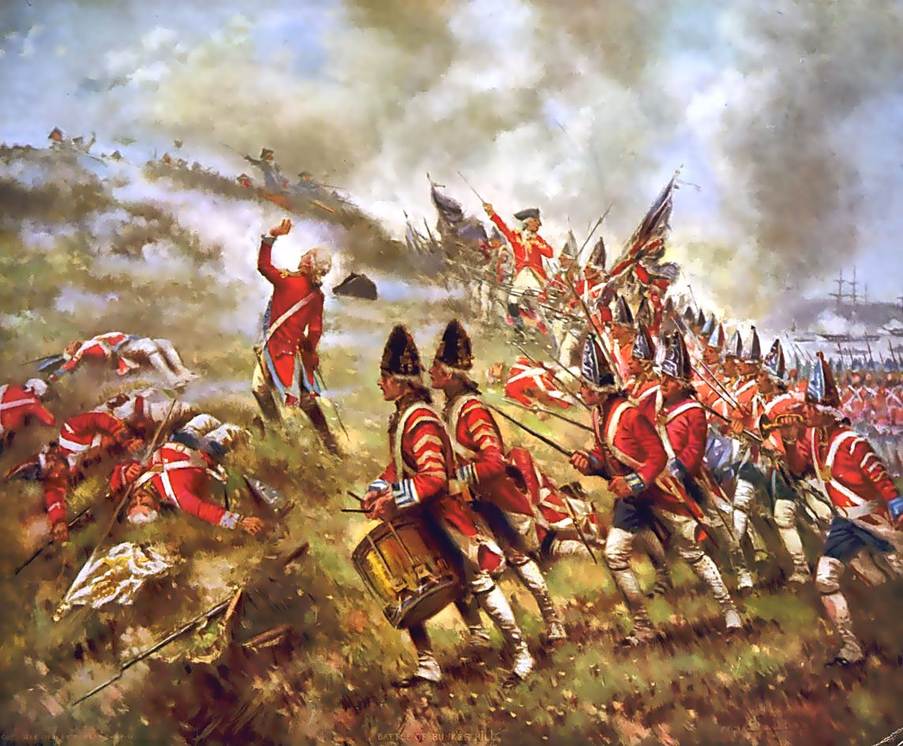
Whites of Their Eyes
The colonial soldiers knew that they had to save their bullets. If they shot while the redcoats were too far away, they might miss.
So, the leader of the colonists said “Don’t fire until you see the whites of their eyes.”

Slide 9
Battle of Bunker Hill – Result
Eventually, though, the colonists DID run out of bullets, and the British Soldiers overtook both Bunker Hill and Breed’s Hill.
BUT, the redcoats had lost many soldiers and many more were wounded. The colonists did not have as many deaths or injuries.
Once again, this gave the colonists hope that they could win the war.
http://www.history.com/topics/american-revolution/battle-of-bunker-hill

Slide 10
Brain Break?

Slide 11
Recap
With your SPARK Partner:
What was the outcome of the Battle of Bunker Hill?
Who won?
How?
Who said the phrase “don’t fire until you see the whites of their eyes?” Why?

Slide 12
Projects

