Slide 1
The American Revolution
Day 6

Slide 2
Housekeeping Announcements
Good Grade Challenge – Thursday
Friday – TEST
First half of the AR
Study Guides
Choral-Fest – Today
Future Fair – Friday
Computer Turn-In: May 28
MCA Balloon Day: May 29
Dodgeball: June 2 and 3
Assessments
Behavior
PBIS Snack: June 3

Slide 3
Review
Yesterday, we talked about the Battle of Bunker Hill
With your STEAM Partner…
Why did the colonists and redcoats fight at Breed’s (Bunker) Hill?
At first, the patriots were winning. How?
What were the two things that the 2nd Continental Congress did?
What is the other name for the colonies’ Break-Up Letter

Slide 4
Background
Colonies
England
Patriots
Minutemen
Colonists
Colonial Forces
British Troops
Redcoats
England
British Army

Slide 5
Today
We’ll learn about Washington Crossing the Delaware River and the Battle of Trenton.
We’ll get project work time.
Objectives:
The learner will understand the Battle of Trenton.
I will listen to Mr. Button as he talks about how George Washington led his troops across the Delaware River.
I will be able to tell my partner these questions:
Why was the victory at Trenton so important to the colonists?
What does the famous picture show?

Slide 6
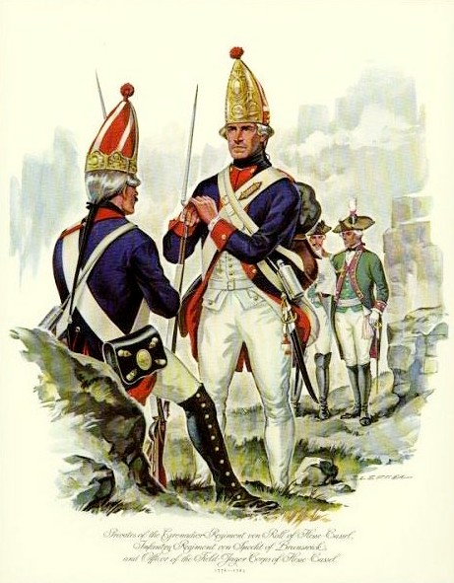
England Gains Momentum
England had started winning more and more battles.
England had brought in allies from Germany known as Hessians.
England’s wealth helped them buy many good supplies.
The colonists were losing, badly.
The colonists were feeling depressed about the war and their hopes at winning.

Slide 7
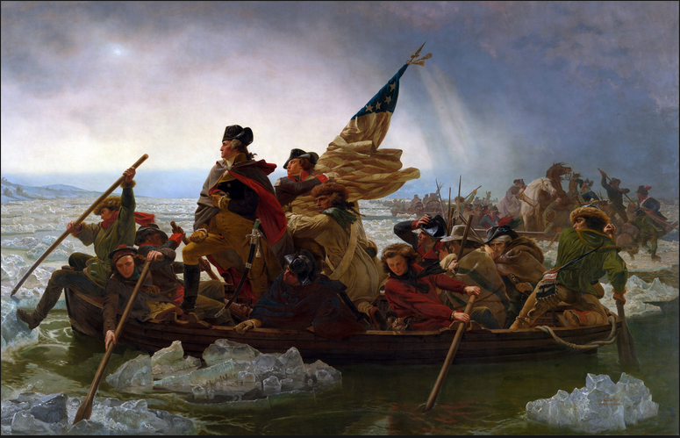
Christmas Day
It was a cold Christmas Day in Virginia.
General Washington knew that his men needed a win to raise their spirits.
At night, Washington leads his men across the frozen Delaware River so they can surprise attack a troop of Hessians in Trenton.
This picture became a very famous painting of Washington. Tell your STEAM Partner why you think that might be.

Slide 8
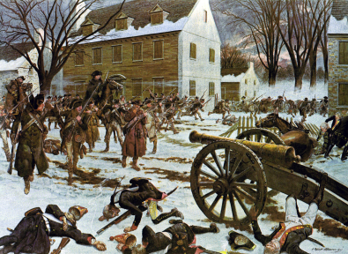
Victory Regains Hope
The Hessians were very tired from the night before…probably because they stayed up too late waiting for Santa.
The colonial troops quickly surrounded Trenton and pushed the Hessians out.
The news of Washington’s victory and his leadership skills once again gave the colonists hope and motivation.

Slide 9
Brain Break?

Slide 10
Recap
With your SPARK Partner:
Why was the victory at Trenton important to the colonists?
What is this picture showing?

Slide 11
Study Time!

Slide 12
Projects

