Slide 1
Causes of the American Revolution
Day 10

Slide 2
Student News
As you’re watching student news, complete the Socrative Quiz.
If you finish early, shut your lid and watch the rest.
When the news is over (in 10 minutes), your time is up.
Click here for the video

Slide 3
Review
Yesterday, we talked about the Intolerable Acts
With your SPARK Partner, answer these questions…
What does the word “intolerable” mean?
Why did the British Parliament create them?
Name two of the laws in the intolerable acts.
You have 45 seconds. Blue starts

Slide 4
Test Review
With your STEAM partner
Blue partner take out your bag of study cards.
Find these cards
Boston Massacre
Sugar Act
Intolerable Acts
French and Indian War
Stamp Act
Boston Tea Party
Together with your partner, put these events in order and tell each other about them.
You have 2 minutes.

Slide 5
Today
We’ll discuss the First Continental Congress
You’ll get project work time. ☺
Objectives
The learner will understand the causes and effects of the First Continental Congress
I will listen as Mr. Button talks about the First Continental Congress. I will be able to tell my partner these questions.
Why did representatives from the colonies need to meet?
Where was the Continental Congress held?
What was the effects of the Continental Congress?

Slide 6
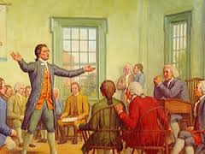
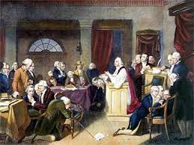
The First Continental Congress (1774)
Most colonists believed that England and the parliament had gone too far with the taxes and laws.
It was clear that the colonies had to do something about this.
In September of 1774, delegates (representatives) from each colony met in Philadelphia to discuss what they could do.
Now fill out the first part of your notes.

Slide 7
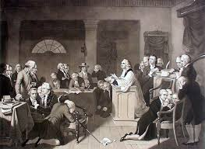
Result of the 1st Continental Congress
Each colony had a different opinion of what to do.
Some wanted to break away from England completely
Some wanted to find a way to get along with England
In the end, the 1st CC sent a request to the Parliament. It said…
Colonists should have the right to “life, liberty, and property.”
They believed only colonies should be able to tax colonists, not England
After the request was sent, the colonies also stopped trade with England.
Now you can fill out your notes.

Slide 8
Brain Break
https://www.gonoodle.com/dashboard

Slide 9
Review
With your STEAM Partner, answer these questions…
(1 minute . Green first)
Why did representatives from the colonies need to meet?
Where was the Continental Congress held?
What was the effects of the Continental Congress?

Slide 10
Homework
Your homework tonight is to study for tomorrow’s test!!!
Use your study cards.
Use your notes.
For tomorrow’s test, you’ll only need to know the events that are on your study cards (which are the same as the events on the posters).

Slide 11
Work Time
Today, make sure you have the following events included in your timeline.
French and Indian War
Sugar Act
Stamp Act
Quartering Act
Townshend Acts
Boston Massacre
Tea Act
Boston Tea Party
Intolerable Acts
First Continental Congress
If you get done early, you can…
*study for the test
*make your timeline better
*start creating an extra timeline project
Red words mean that this event WON’T be on the test.

