Slide 1
Causes of the American Revolution
No Student News today.
Have a seat and be ready to learn.
Day 2

Slide 2
Announcements & Housekeeping
Friday:
End of the quarter
Early release
Beach day for all
Movie for no referrals
Lockdown Tuesday
Fire Drill Thursday
Peer Power Partners at 2:00 Thursday
Mr. Button gone Thursday morning
Grades are up to date.
Turn in the FP Projects as soon as possible!!

Slide 3
Review
Last week, you read a section of the textbook that talked about the French and Indian War.
I told you what this unit will look like.

Slide 4
Unit Map
Standard: Identify major conflicts between the colonies and England following the Seven Years’ (French and Indian) War; explain how these conflicts led to the American Revolution.
Monday | Tuesday | Wednesday | Thursday | Friday
French and Indian War | Quartering Act & Proclamation of 1763 | Stamp Act & No Taxation without Representation | Townshend Acts | (Very short classes) Tax Simulation
Spring Break | Spring Break | Spring Break | Spring Break | Spring Break

Slide 5
Today
We’ll discuss as a class what we learned about the French and Indian War.
We’ll look at the projects for this unit.
Objectives
The learner will understand the basic concepts of the French and Indian War and summarize it with a partner.
I will be able tell answer these questions for my partner:
Who fought in the French and Indian War?
Why did they fight?
Who won? What was a result of their winning?

Slide 6
Note Sheet
Take with you OR leave here.
Decide which is best for you.

Slide 7
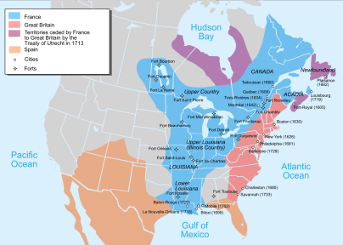
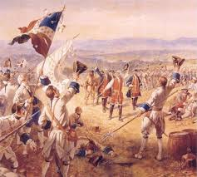
French and Indian War
France and Great Britain fought over land west of the Appalachian Mountains.
Native Americans (Indians) fought on both sides.
At first, France was winning.
Then, things changed….

Slide 8
French and Indian War
William Pitt (from England) developed a strategy to help the British defeat the French
England had a better Navy and blocked France from the New World
England made allies with two powerful Native American tribes
France surrenders in 1760
Treaty of Paris gave most of the land to England

Slide 9
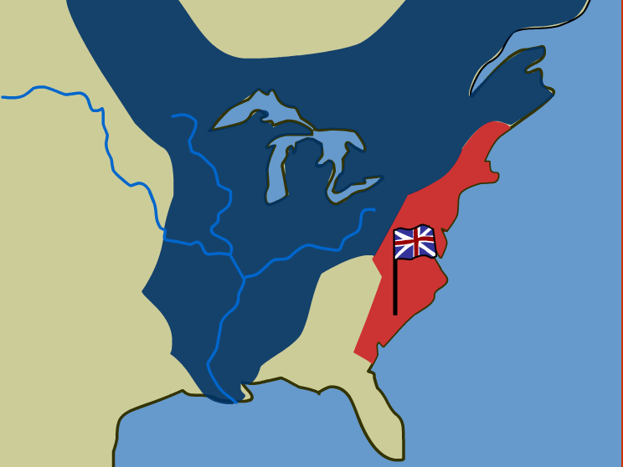

Slide 10
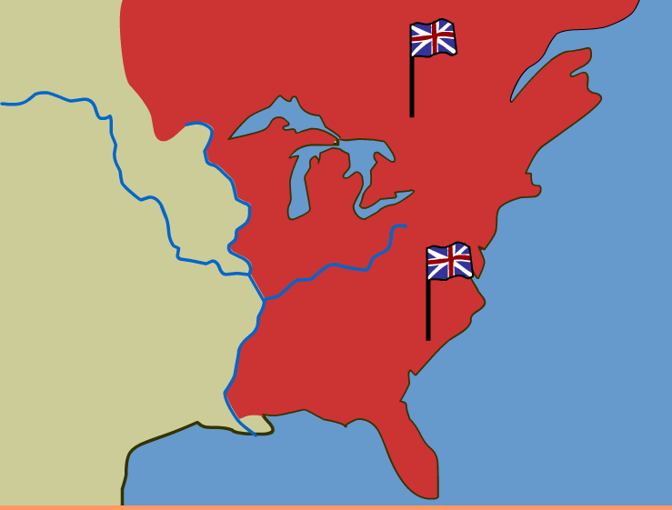

Slide 11
Review
With your STEAM Partner, answer these questions…
Who fought in the French and Indian War?
Why did they fight?
Who won? What was a result of their winning?

Slide 12
Brain Break
https://www.gonoodle.com/dashboard

Slide 13
Project Sheet
Causes of the American Revolution Timeline PROJECTS - full sheet.docx

