Slide 1
Causes of the American Revolution
Day 4

Slide 2
Announcements & Housekeeping
Friday:
End of the quarter
Early release
Beach day for all
Movie for no referrals
Fire Drill Thursday
Peer Power Partners at 2:00 Thursday
Mr. Button gone Thursday morning
Grades are up to date.
Turn in the FP Projects as soon as possible!!

Slide 3
Review
Yesterday, we discussed the Sugar and Stamp Acts.
With your SPARK Partner, answer these questions…
What is a tax?
What is the Stamp Act and Sugar Act?
Why did England create them?
How did the colonists respond to the Stamp and Sugar Act?

Slide 4
Unit Map
Standard: Identify major conflicts between the colonies and England following the French and Indian War; explain how these conflicts led to the American Revolution.
Monday | Tuesday | Wednesday | Thursday | Friday
French and Indian War | Sugar Act & Stamp Act | No Taxation without Representation & Quartering Act | Townshend Acts | (Very short classes) Tax Simulation
Spring Break | Spring Break | Spring Break | Spring Break | Spring Break
Boston Massacre | Tea Act & Boston Tea Party | Intolerable Acts | First Continental Congress | Test Day

Slide 5
Today
We’ll discuss the Quartering Act and No Taxation without Representation.
You’ll get project work time.
Objectives
The learner will understand the Quartering Act and the slogan “No Taxation without Representation”
I will listen as Mr. Button talks about the Quartering Act. I will be able to tell my partner these questions.
What is the Quartering Act?
How are the colonists probably feeling about England at this point?
Finish the sentence: “No Taxation without __________.”
What does that slogan mean?

Slide 6
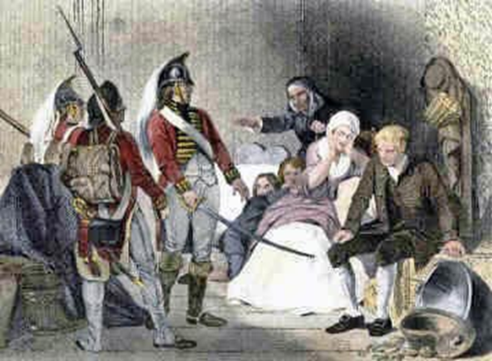
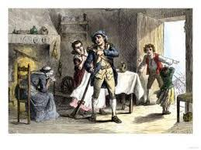
Quartering Act (1765)
England was still sending soldiers to the colonies to keep them safe from the Native Americans.
Sometimes, the barracks would get too full, so England passed a law called the Quartering Act, which stated that colonists were required to provide food, shelter, and a bed for any British soldier who needed it.
Once again, the colonists resented being told what to do by England and they refused to obey the law.

Slide 7
No Taxation without Representation !
The colonists were getting more and more angry with England and the King and the Parliament.
They were angry that they did not have a voice (or representation in England).
HOT Question: How is this different from today?
The colonists created a slogan (or saying) that showed their frustration…
No taxation without representation

Slide 8
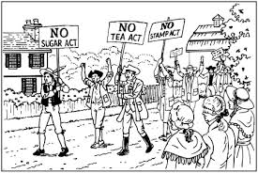
No Taxation without Representation!
This means “We should not have to pay taxes to England if we have no voice in their government.”

Slide 9
Brain Break
https://www.gonoodle.com/dashboard

Slide 10
Review
With your STEAM Partner, answer these questions…
What is the Quartering Act?
How are the colonists probably feeling about England at this point?
Finish the sentence: “No Taxation without __________.”
What does that slogan mean?

Slide 11
Projects
Each day, you will add to your timeline. Today, you will add “The Quartering Act” to your timeline.
It is a GREAT idea to finish at home if you don’t get the day’s work done during work time. Otherwise, you’ll get too far behind.

Slide 12
Work Time
Start with which kind of timeline you want to make.
Then find a partner with the same interests (if you want a partner).
You and your partner may work together and turn in ONE project, BUT I have to see you collaborating…or you’ll be split up.

