Slide 1
Causes of the American Revolution
Day 7

Slide 2
Announcements & Housekeeping
Computer Checks this week
Seating this week
Mr. Button gone Thursday morning
Grades start over today.
Good Grade Challenge:
Friday, April 24th

Slide 3
Classroom Behavior

Slide 4
Review
Before the break, we talked about the different things that caused the American Revolution
With your SPARK Partner, answer these questions…
What was the result of the French and Indian War?
What is a tax?
What is the Stamp Act and Sugar Act?
How did the colonists respond to the Stamp and Sugar Act? (Think of the M&M activity from last Friday).

Slide 5
Unit Map
Standard: Identify major conflicts between the colonies and England following the French and Indian War; explain how these conflicts led to the American Revolution.
Monday | Tuesday | Wednesday | Thursday | Friday
French and Indian War | Sugar Act & Stamp Act | No Taxation without Representation & Quartering Act | Townshend Acts | (Very short classes) Tax Simulation
Spring Break | Spring Break | Spring Break | Spring Break | Spring Break
Boston Massacre | Tea Act & Boston Tea Party | Intolerable Acts | First Continental Congress | Test Day

Slide 6
Unit Test – Friday
What it will look like.
How to study.

Slide 7
Today
We’ll discuss the Boston Massacre
You’ll get project work time.
Objectives
The learner will understand the Boston Massacre
I will listen as Mr. Button talks about the Boston Massacre. With my partner, I’ll be able to answer these questions…
What was the Boston Massacre?
What was the result of the Boston Massacre?
What was Paul Revere’s role?

Slide 8
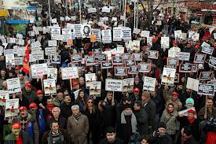
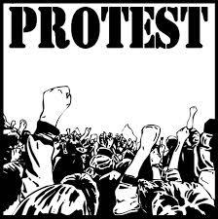
Boston Massacre (1770)
Colonists were still very upset about England’s decision to tax them without having a voice in the Parliament.
Colonists began to protest England, the King, and the Parliament.

Slide 9
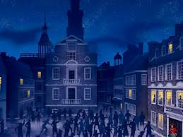
Boston Massacre
On March 5th, British soldiers open fired on a group of protesting colonists.
The events that led to the open fire are not exactly known to anyone.
?

Slide 10
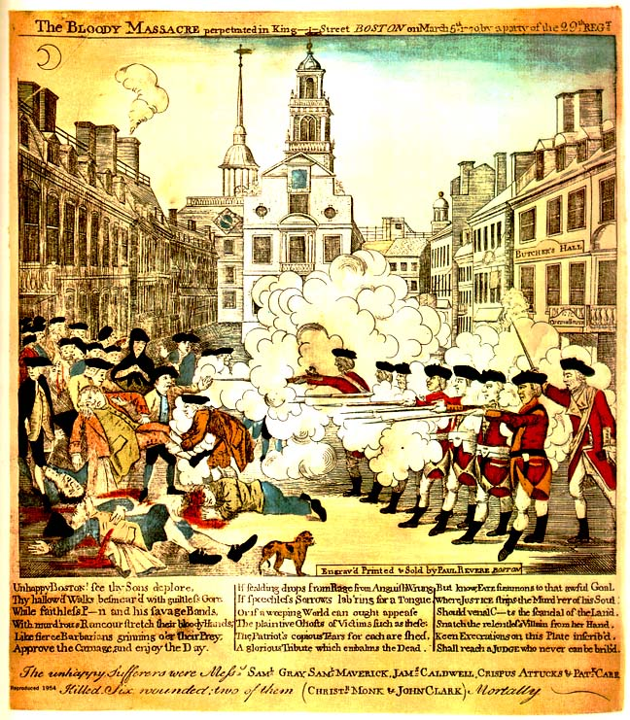
Result of the Boston Massacre
Paul Revere (who also rode his horse to town, warning colonists that the British were coming) made an engraving (or etching) that showed his point of view of what happened?
After seeing this etching, the colonists were very angry with the British soldiers.
HOT Question: Paul Revere was a colonists and a member of the Sons of Liberty. What do you think his purpose was when he made the etching?

Slide 11
Brain Break
https://www.gonoodle.com/dashboard

Slide 12
Review
With your STEAM Partner, answer these questions…
What was the Boston Massacre?
What was the result of the Boston Massacre?
What was Paul Revere’s role?

Slide 13
Projects
Each day, you will add to your timeline. Today, you will add “The Boston Massacre” to your timeline.
Homework: Complete the Boston Massacre piece of your timeline project

Slide 14
Today
We’ll discuss the Boston Massacre
You’ll get project work time.
Objectives
The learner will understand the Boston Massacre
I will listen as Mr. Button talks about the Boston Massacre. With my partner, I’ll be able to answer these questions…
What was the Boston Massacre?
What was the result of the Boston Massacre?
What was Paul Revere’s role?

