Slide 1
Causes of the American Revolution
Day 8

Slide 2
Announcements & Housekeeping
Mower Refreshed today
Computer Checks this week
Mr. Button gone Thursday morning
Grades start over today.
Good Grade Challenge:
Friday, April 24th
I’ll put in quiz grades tomorrow

Slide 3
Classroom Behavior – Tomorrow

Slide 4
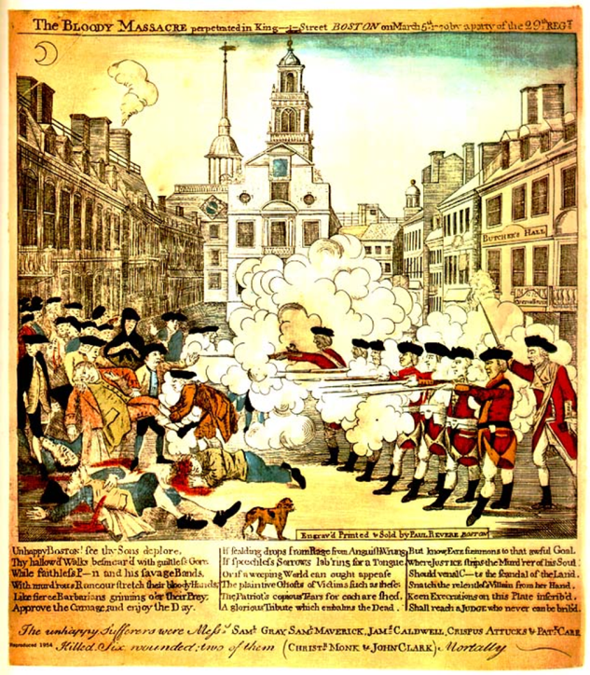
Review
Yesterday, we talked about the Boston Massacre
With your SPARK Partner, answer these questions…
What was the Boston Massacre?
How did Paul Revere’s drawing make colonists feel?
You have 30 seconds.

Slide 5
Unit Map
Standard: Identify major conflicts between the colonies and England following the French and Indian War; explain how these conflicts led to the American Revolution.
Monday | Tuesday | Wednesday | Thursday | Friday
French and Indian War | Sugar Act & Stamp Act | No Taxation without Representation & Quartering Act | Townshend Acts | (Very short classes) Tax Simulation
Spring Break | Spring Break | Spring Break | Spring Break | Spring Break
Boston Massacre | Tea Act & Boston Tea Party | Intolerable Acts | First Continental Congress | Test Day

Slide 6
Test Review
With your STEAM partner
Green partner take out your bag of study cards.
Find these cards
Boston Massacre
Sugar Act
French and Indian War
Stamp Act
Together with your partner, put these events in order and tell each other about them.
You have 2 minutes.

Slide 7
Today
We’ll discuss the Tea Acts and the Boston Tea Party
You’ll get project work time…hopefully
Objectives
The learner will understand the causes and effects of the Tea Acts and the Boston Tea Party.
I will listen as Mr. Button talks about the Tea Acts and the Boston Tea Party. I will be able to tell my partner these questions.
What were the Tea Acts? Why were they created? Who created them?
What was the Boston Tea Party? Who was the group that did it? Why did they do it?

Slide 8
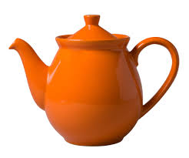
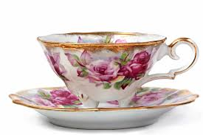
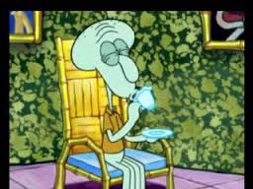
Tea Acts (1773)
The Parliament repealed (got rid of) the Townshend Acts. However, they still wanted to tax colonists on Tea.
They started the Tea Acts. The Tea Acts taxed the tea that colonists bought and made England the only country where the colonists could buy tea.

Slide 9
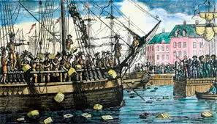
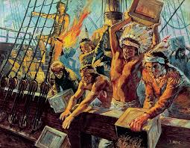
Boston Tea Party (1773)
To show their anger at Parliament, a group of colonists known as the Sons of Liberty dressed up as Mohawk Indians and dumped 342 chests of tea on a ship into the Boston Harbor.
HOT Question: Why did they dress up?

Slide 10
Brain Break
https://www.gonoodle.com/dashboard

Slide 11
Review
With your STEAM Partner, answer these questions…
(2 minutes)
What were the Tea Acts? Why were they created? Who created them?
What was the Boston Tea Party? Who was the group that did it? Why did they do it?

Slide 12
Projects
Each day, you will add to your timeline. Today, you will add “The Boston Massacre” and “Tea Acts” and “Boston Tea Party” to your timeline.
Homework: Complete the “Tea Acts” and “Boston Tea Party” part of your timeline.

Slide 13
Today
We’ll discuss the Tea Acts and the Boston Tea Party
You’ll get project work time…hopefully
Objectives
The learner will understand the causes and effects of the Tea Acts and the Boston Tea Party.
I will listen as Mr. Button talks about the Tea Acts and the Boston Tea Party. I will be able to tell my partner these questions.
What were the Tea Acts? Why were they created? Who created them?
What was the Boston Tea Party? Who was the group that did it? Why did they do it?

