Slide 1
Causes of the American Revolution
Day 9

Slide 2
Announcements & Housekeeping
Computer Checks this week
Mr. Button gone Thursday morning
Reading MCA’s next week.
Grades are not updated. Sorry. ☹
Good Grade Challenge:
Friday, April 24th
I’ll put in quiz grades tomorrow

Slide 3
Classroom Behavior – Next Week

Slide 4
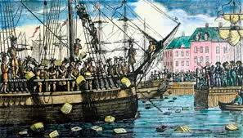
Review
Yesterday, we talked about the Boston Tea Party.
With your SPARK Partner, answer these questions…
What was the Boston Tea Party?
Who threw the tea overboard?
Why did they do it?
You have 45 seconds. Blue starts

Slide 5
Unit Map
Standard: Identify major conflicts between the colonies and England following the French and Indian War; explain how these conflicts led to the American Revolution.
Monday | Tuesday | Wednesday | Thursday | Friday
French and Indian War | Sugar Act & Stamp Act | No Taxation without Representation & Quartering Act | Townshend Acts | (Very short classes) Tax Simulation
Spring Break | Spring Break | Spring Break | Spring Break | Spring Break
Boston Massacre | Tea Act & Boston Tea Party | Intolerable Acts | First Continental Congress | Test Day

Slide 6
Test Review
With your STEAM partner
Blue partner take out your bag of study cards.
Find these cards
Boston Massacre
Sugar Act
French and Indian War
Stamp Act
Boston Tea Party
Together with your partner, put these events in order and tell each other about them.
You have 2 minutes.

Slide 7
Which test do you think you want?
Test 0 – No help, just the NAMES of the events
Test 1 – 0 with a word bank
Test 2 – The names of the events are in order for you. You have to describe them.
Test 3 – 2 with a word bank
Test 4 – The names of the events are provided for you and you must fill in the blanks in the descriptions
Test 5 – 4 with a word bank
Heads down count. Thanks for being respectful of your classmates.

Slide 8
Today
We’ll discuss the Intolerable Acts
You’ll get project work time. ☺
Objectives
The learner will understand the causes and effects of the Intolerable Acts.
I will listen as Mr. Button talks about the Intolerable Acts. I will be able to tell my partner these questions.
What does the word intolerable mean?
What were the Intolerable Acts? Why did Parliament pass them?

Slide 9
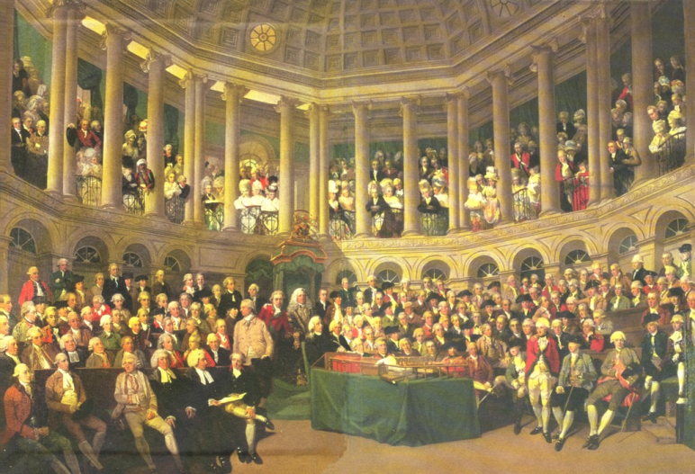
Intolerable Acts (1774)
The Parliament heard about the Boston Tea Party. They knew that it was the Sons of Liberty who threw the tea into the Harbor. Parliament was pretty angry.
The Parliament passed a bunch of new taxes and laws.
The Colonists called them “Intolerable” which means “Unacceptable.”
Now you can fill out your notes.

Slide 10
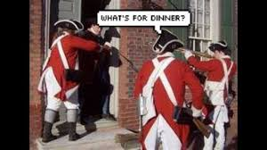
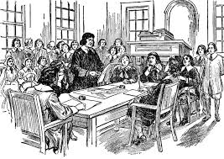
Intolerable Acts – The Laws (1774)
The Boston Harbor is closed until the colonists pay for the tea they destroyed.
The colony of Massachusetts is not allowed to make their own laws. No one in Massachusetts can have a town meeting.
The Quartering Act is back.
Now you can fill out your notes.

Slide 11
Brain Break
https://www.gonoodle.com/dashboard

Slide 12
Review
With your STEAM Partner, answer these questions…
(1 minute . Green first)
What does the word intolerable mean?
What were some of the Intolerable Acts?
Why did Parliament pass them?

Slide 13
Homework
Study for the test!!!!
The timeline projects are due on Monday. You have all weekend to finish them.
The test on Friday is worth 20 assessment points!!!!
At home tonight, studying for the test FIRST, then do your project.

Slide 14
Projects
Each day, you will add to your timeline. Today, you will add “The Intolerable Acts” to your project.

