Slide 1
Christopher Columbus

Slide 2
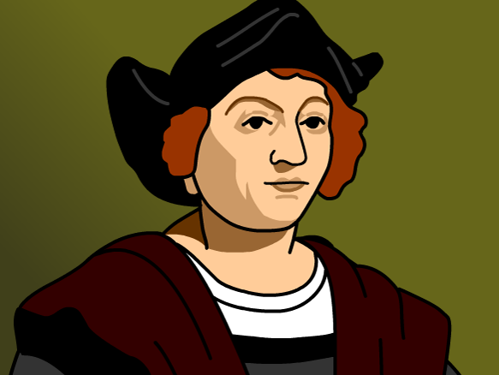

Slide 3
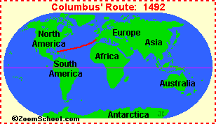
Fast Facts
King of Spain asked him to find a new route to Asia.
He thought the world was round and that a faster route to Asia could be found by travelling west.

Slide 4
Discovery
He landed in San Salvador in 1492.
He returned to Spain (in Europe) and told everyone that he really DID discover a new route to Asia.

Slide 5
Legacy
Now we celebrate him on Columbus Day every year.
However, some people are not fans of Columbus because they think he treated the natives poorly.

