Slide 1
English, French, Spanish Colonies
Day One
Jour Un
Dia Uno

Slide 2
Housekeeping
Continue to work on your tests.
Before School
After School
Study Hall
During the Student News
Shortened Class Today due to Mower Refreshed Assembly
Hand in your Projects

Slide 3
Announcements
Chemical Health Awareness Week
Today: Don’t let drugs mess up your life
Tomorrow: The best of me is drug free
Mr. Button will be gone on Thursday morning

Slide 4
Unit Road Map
Monday | Tuesday | Wednesday | Thursday | Friday
23 Thirteen Colonies Test Day | 24 (short class) Spanish Colonies | 25 Spanish Colonies | 26 (Mr. Button gone) French Colonies | 27 French Colonies
2 Projects Due | 3 | 4 | 5 | 6

Slide 5
Review
Yesterday, you took a test on the 13 colonies and how they were different.
Before that, we talked about how people from Europe had been coming to the “New World” for the 3 G’s
Gold
Glory
God

Slide 6
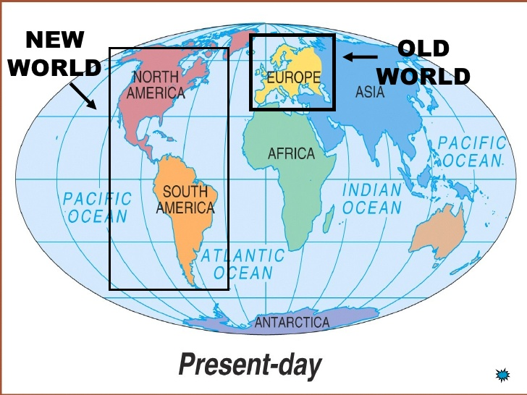
Geography

Slide 7
Three Main Countries Going to the New World

Slide 8
Today
You’ll learn about the Spanish Colonies and take some notes.
You’ll see the project sheet for the unit.
Objectives
The learner will understand the geography and economy of the Spanish Colonies in the 1700’s.
I will take notes on where Spanish Colonies were and how they made money. I’ll be able to discuss with my partner these questions.
Where were the Spanish Colonies in the 1700’s?
How did they make money?

Slide 9
Your Note Sheet
Your note sheet has two sides.
One side has a table for you to take notes (write small!!!!)
The other has the projects you can do.
We’ll discuss the projects later. Turn to the side with the table of notes.

Slide 10
Who Ruled What?

Slide 11
Notes
 | Geography
Spanish Colonies | Spanish explorers found and claimed these places (that we know today)… The Caribbean (including Cuba) Florida Southern Texas Central and South America (including Mexico)

Slide 12
Notes
 | Economy
Spanish Colonies | Most Spanish Colonies made money by… Trading Some farming

Slide 13
Brain Break
https://www.gonoodle.com/dashboard

Slide 14
Recap
With your STEAM Partner… (see if you can do this without your notes) …for a prize!!
Where were the Spanish colonies?
How did they make money?

Slide 15
This Unit’s Projects

Slide 16
Review Today
You’ll learn about the Spanish Colonies and take some notes.
You’ll see the project sheet for the unit.
Objectives
The learner will understand the geography and economy of the Spanish Colonies in the 1700’s.
I will take notes on where Spanish Colonies were and how they made money. I’ll be able to discuss with my partner these questions.
Where were the Spanish Colonies in the 1700’s?
How did they make money?

Slide 17
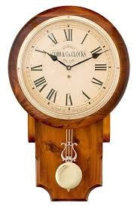
Work Time

