Slide 1
English, French, Spanish Colonies
Day Two
Jour Deux
Dia Dos

Slide 2
Housekeeping
Take the PILOT survey

Slide 3
Announcements
Chemical Health Awareness Week
Today: The Best of Me is Drug Free (Dress your best)
Tomorrow: Be a Hero. Your Drug Use should be Zero (Dress up as your hero)
Tomorrow: Mr. Button gone in the AM.
Today: Club Pictures

Slide 4
Unit Road Map
Monday | Tuesday | Wednesday | Thursday | Friday
23 Thirteen Colonies Test Day | 24 (short class) Spanish Colonies | 25 Spanish Colonies | 26 (Mr. Button gone) French Colonies | 27 French Colonies
2 Projects Due | 3 | 4 | 5 | 6

Slide 5
Review
Yesterday, you took some notes on Spanish Colonies.
With your STEAM Partner, answer these two questions.
Where were the Spanish Colonies Located?
How did they make money?
 | Spanish Colonies
Geography | The Caribbean Florida South Texas Central and South America
Economy | Trading Farming

Slide 6
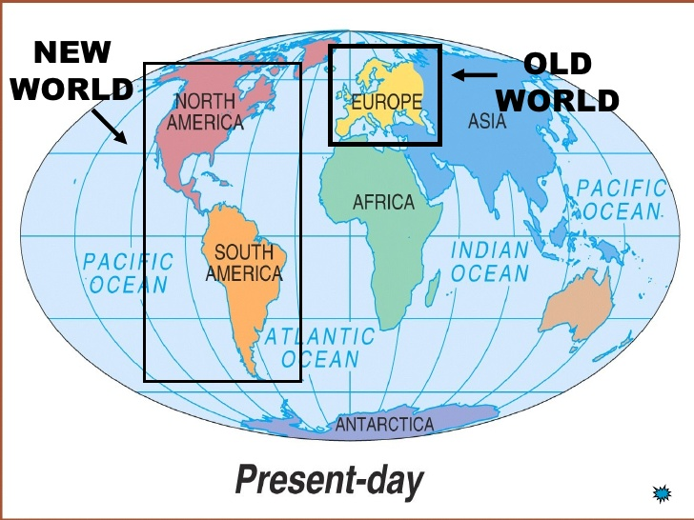
Geography
Tell your SPARK partner what this map is showing us. Be ready to explain it.

Slide 7
Three Main Countries Going to the New World

Slide 8
Today
You’ll learn about the Spanish Colonies and take some notes.
You’ll see the project sheet for the unit.
Objectives
The learner will understand the religion of the Spanish colonies, as well as how the government worked and how they got along with the natives.
I will take notes on the Spanish Colonies. By the end of the lesson, I will be able to tell a partner:
What was the religion of the Spanish colonies?
How did the Spanish Colonists get along the natives?
How were the Spanish Colonies run?

Slide 9
Who Ruled What?
Tell your SPARK partner about this map.
What conclusions can you draw from it?
Be ready to answer and summarize what people have said!

Slide 10
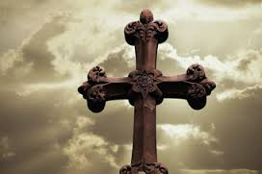
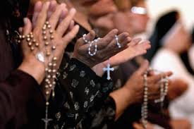
 | Religion
Spanish Colonies | Spanish Colonists were all Catholic. Catholicism is an old religion whose members follow the bible very closely. Anyone who was not Catholic was banished from the colony.

Slide 11
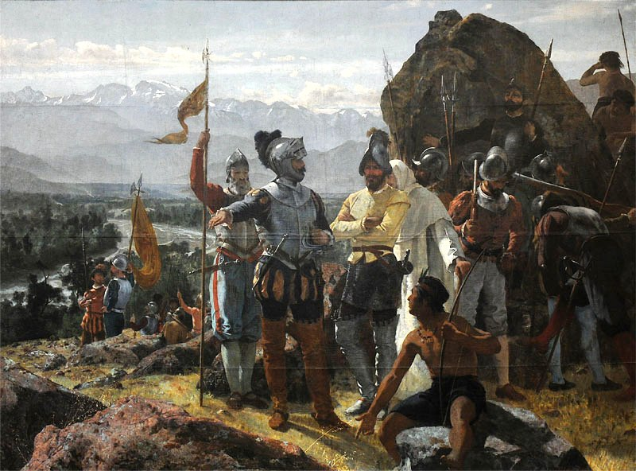
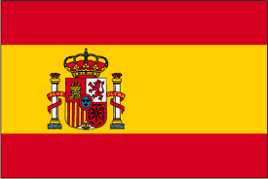
 | Relations with Natives
Spanish Colonies | Because the Spanish had such a strong religion, they saw the natives as heathens (people who didn’t believe in God) and did not care if they killed them or made them slaves.

Slide 12
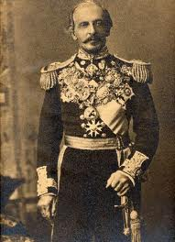
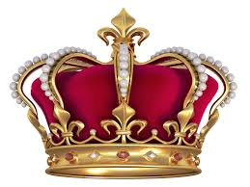
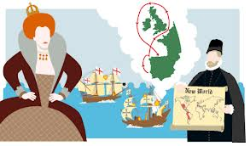
 | Government
Spanish Colonies | Settlers (people who came to the New World) were ruled by the king or queen. The king appointed (chose) a governor or viceroy to control and run the colonies exactly the way the King wanted it to be run.

Slide 13
Brain Break
https://www.gonoodle.com/dashboard

Slide 14
Recap
With your STEAM Partner… (see if you can do this without your notes) …for a prize!!
What was the religion of the Spanish colonies?
How did the Spanish Colonists get along the natives?
How were the Spanish Colonies run?

Slide 15
This Unit’s Projects
English French Spanish Assignment Sheet NEW.docx

Slide 16
Today
You’ll learn about the Spanish Colonies and take some notes.
You’ll see the project sheet for the unit.
Objectives
The learner will understand the religion of the Spanish colonies, as well as how the government worked and how they got along with the natives.
I will take notes on the Spanish Colonies. By the end of the lesson, I will be able to tell a partner:
What was the religion of the Spanish colonies?
How did the Spanish Colonists get along the natives?
How were the Spanish Colonies run?

Slide 17
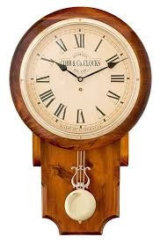
Work Time

