Slide 1
English, French, Spanish Colonies
Day Four
Jour Quatre
Dia Cuatro

Slide 2
Announcements
Chemical Health Awareness Week
Today: Wear Read and Hat Day (for $1)

Slide 3
Unit Road Map
Monday | Tuesday | Wednesday | Thursday | Friday
23 Thirteen Colonies Test Day | 24 (short class) Spanish Colonies | 25 Spanish Colonies | 26 French Colonies | 27 French Colonies
2 Projects Due | 3 | 4 | 5 | 6

Slide 4
Review
Yesterday, you took some notes on French Colonies.
With your STEAM Partner, answer these questions.
Where were the French Colonies located?
How did the French colonies make money? What is fur trading?
How did the French colonists treat the natives?
 | French Colonies
Geography | Eastern Canada Most of the U.S. (including MN)
Economy | Fur Trading
Relations with Natives | Mostly Positive Natives helped France fight England in a war later

Slide 5
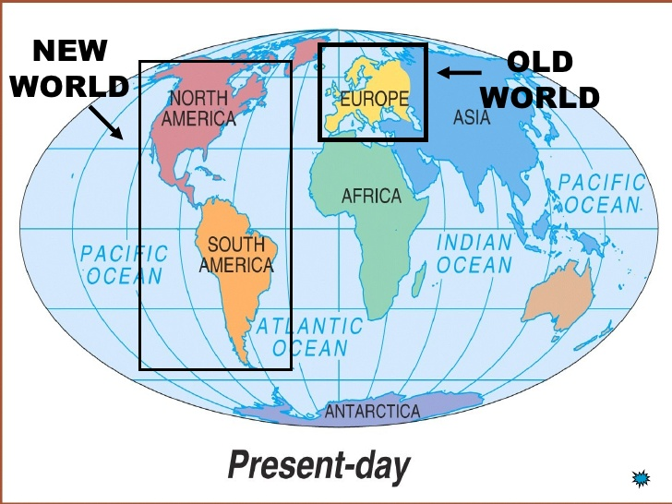

Slide 6
Three Main Countries Going to the New World

Slide 7
Today
You’ll learn about the French Colonies and take some notes.
You’ll get project work time.
Objectives
The learner will understand the religion of the French colonies, as well as how the government worked.
I will take notes on the French Colonies. By the end of the lesson, I will be able to tell a partner:
What was the religion of the French colonies?
What was the government of the French colonies like?
Would you want to be a citizen of a French colony? Why?

Slide 9
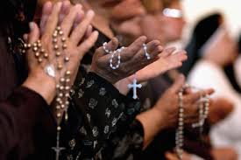
 | Religion
French Colonies | Non-Catholics helped to found the French colonies. However, after 1659 the colonies were controlled by the French Catholic leaders.

Slide 10
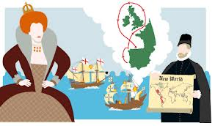
 | Government
French Colonies | Colonies were fully under control of the French King. Colonists had no political rights nor a voice in France. Town meetings were not allowed without permission.
Town Meeting

Slide 11
Brain Break
https://www.gonoodle.com/dashboard

Slide 12
Recap
With your STEAM Partner… (see if you can do this without your notes) …for a prize!!
What was the religion of the French colonies?
What was the government of the French colonies like?
Would you want to be a citizen of a French colony? Why?

Slide 13
Today
You’ll learn about the French Colonies and take some notes.
You’ll get project work time.
Objectives
The learner will understand the religion of the French colonies, as well as how the government worked.
I will take notes on the French Colonies. By the end of the lesson, I will be able to tell a partner:
What was the religion of the French colonies?
What was the government of the French colonies like?

Slide 14
Project Work Time
This is your last day to work in class.
You’ll go work in the FTLA now.
Once you are in the FTLA, get started right away.

