Slide 1
English Colonies
Day 1

Slide 2
Housekeeping
Tests are close to being graded and entered.
Remember the Good Grade Challenge
Time to hand in projects
Hand in your project sheet separately
If you already got a signature on a project, DON’T hand it in

Slide 3
Announcements
Conferences Tuesday – Thursday
See your homeroom teacher if you don’t know when your conference is.
Mr. Button is at a meeting Thursday morning
No school next Monday ☹

Slide 4
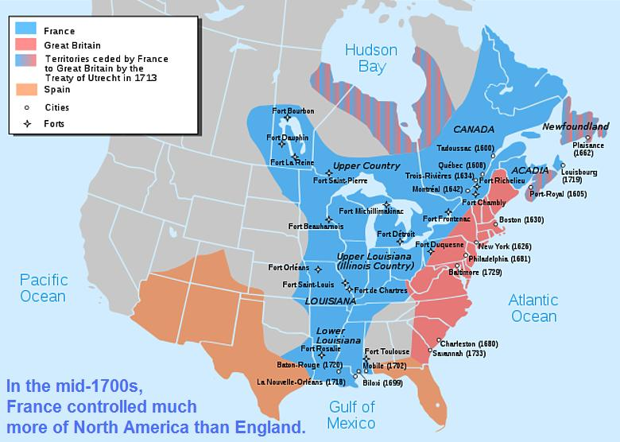
This Week’s Standard
Compare and contrast life within the English, French and Spanish colonies in North America.
The first people who says his/her favorite food aloud gets to pass out the note sheets.
☺

Slide 5
Review
We’ve already studied SOME reasons why people left Europe to go to other places.
Religion
Trading
Slavery
What do you think might be some other reasons?
One together
Rally robin with your STEAM partner

Slide 6
Today
You’ll learn some basic information about the 13 English colonies
You’ll take some notes
You’ll learn about the projects for the week
Objectives
The learner will synthesize important information on his/her note sheet. The learner will get basic information about the 13 English colonies
I will watch a video about the 13 colonies. During the video I’ll tell my partner the 5 W’s about the 13 colonies.

Slide 7
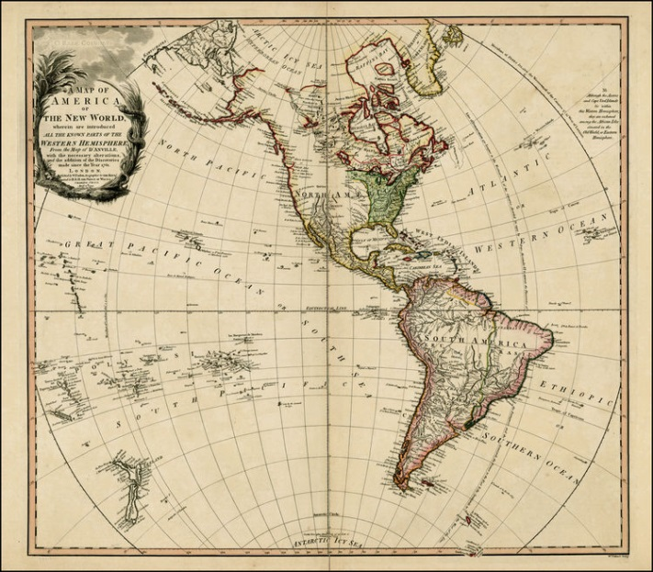
Background
So, as more and more people began exploring the world and discovering new places, OTHERS started making the trip to the new world.

Slide 8
Europe
The people who made the voyage were from different parts of Europe. Over the next two weeks, we’ll talk about the people who came from England, Spain, and France.

Slide 10
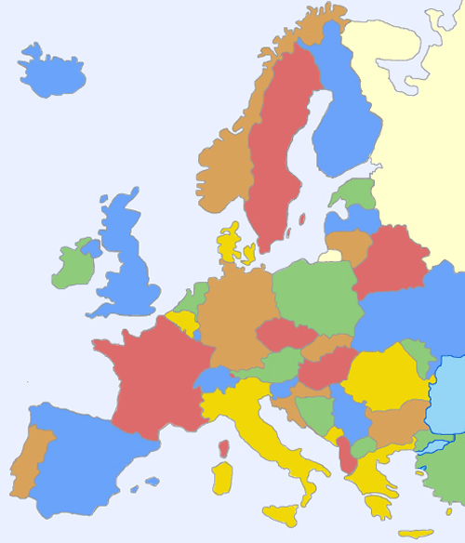

Slide 11
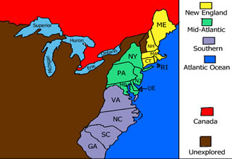
13 English Colonies
You may have heard of the 13 original colonies.
These were the first 13 communities that people from England created when they arrived.
This week, our focus will be on these colonies.

Slide 12
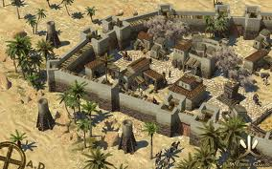
Colonies
As people from Europe (this week, we’re talking mostly about people from England) came, they set up something called colonies.
A colony is a community that people create in a new place.

Slide 13
BrainPop
https://www.brainpop.com/socialstudies/ushistory/thirteencolonies/

Slide 14
Recap
Tell your SPARK Partner about the 13 colonies.
Who
What
Where
When
Why

Slide 15
Brain Break
https://www.gonoodle.com/dashboard

Slide 16
Projects
English Colonies Assignment Sheet.docx

Slide 17
Today
You’ll learn some basic information about the 13 English colonies
You’ll take some notes
You’ll learn about the projects for the week
Objectives
The learner will synthesize important information on his/her note sheet. The learner will get basic information about the 13 English colonies
I will watch a video about the 13 colonies. During the video I’ll take notes and then discuss my notes with my partner.

Slide 18
Work Time

