Slide 1
English Colonies
Day 2

Slide 2
Housekeeping
All grades are as up-to-date as I can make them.
ATS Tests (that were finished) and projects
Great job with the Good Grade Challenge!!!!
Keep it up!!!

Slide 3
Announcements
Conferences Today – Thursday
See your homeroom teacher if you don’t know when your conference is.
Mr. Button is at a meeting Thursday morning
No school next Monday ☹

Slide 4
Change to this Unit
I thought we were going to finish this unit by Friday.
I changed my mind.
We will now spend 2 weeks on it, so we can learn more about these first 13 colonies and so you can have more time on your projects.
Monday | Tuesday | Wednesday | Thursday | Friday
Introduction | Big Picture | New England Colonies (short) | New England Colonies (sub) | Middle Colonies
No School | Middle Colonies | Southern Colonies | Southern Colonies | Test

Slide 5
So…
Your projects won’t be due until Tuesday, February 24th (I’ll be gone that Monday)
Your assignment is to complete 13 project points.
This gives you a good amount of time to do your BEST WORK.

Slide 6
Review
Yesterday, we got an introduction and basic info about the 13 colonies.
Mix, Pair, Share
Which country (and continent) did most of the people from the 13 colonies come from?
What is a colony?
What are the three regions of colonies?

Slide 7
Today
You’ll learn the basic differences between the three regions of colonies.
You’ll take some notes
Objectives
The learner will compare and contrast the three regions of the 13 colonies.
I’ll take some notes on the colonies and work in a group of three to compare the New England, Middle, and Southern colonies.

Slide 8
Map of the World
Let’s not forget where these things are happening.

Slide 10
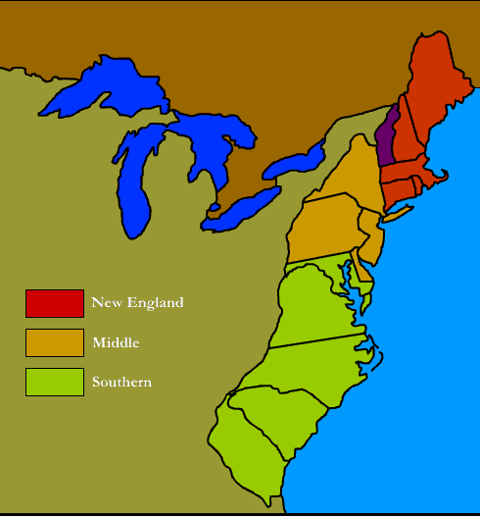
Notes
The colonies were divided into three regions.
New England
Middle
Southern
Here is some BASIC information about each region. (We’ll learn more later this week and next)

Slide 11
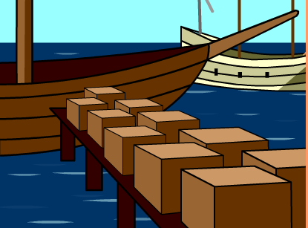
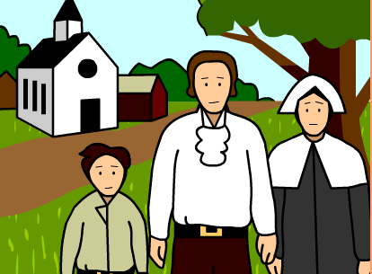
New England Colonies
Came to America for religious freedom.
Fisherman
Merchants (someone who buys and sells things)

Slide 12
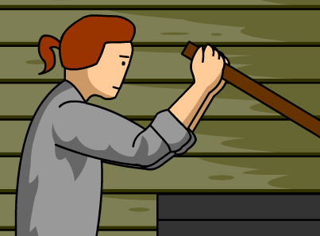
Middle Colonies
Diversity (lots of different kinds of people)
Farming
Factories

Slide 13
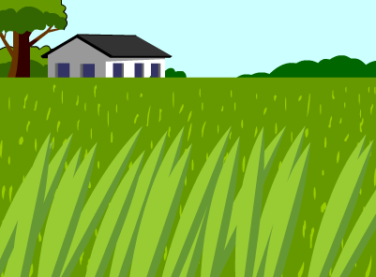
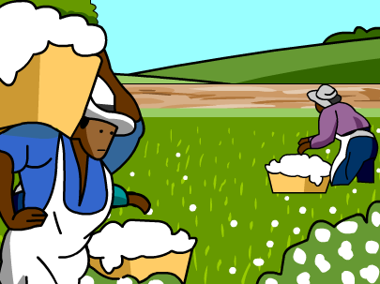
Southern Colonies
Plantations
Slaves

Slide 14
Brain Break
https://www.gonoodle.com/dashboard

Slide 15
Recap
Letter ABC
A = New England
B = Middle
C = Southern
Letter DEF
D = New England
E = Middle
F = Southern
Say one thing that is unique about your region. (something that makes yours different from the other two)
A and D start. One at a time.

Slide 16
Projects
English Colonies Assignment Sheet.docx

Slide 17
Today
You’ll learn the basic differences between the three regions of colonies.
You’ll take some notes
Objectives
The learner will compare and contrast the three regions of the 13 colonies.
I’ll take some notes on the colonies and work in a group of three to compare the New England, Middle, and Southern colonies.

Slide 18
Work Time

