Slide 1
English Colonies
Day 3

Slide 2
Housekeeping
Grades are as up-to-date as I can make them.
Great job with the Good Grade Challenge!!!!
Keep it up!!!

Slide 3
Announcements
Conferences Tuesday-Thursday
Mr. Button is at a meeting Thursday morning
No school next Monday ☹

Slide 4
Unit Road Map
Monday | Tuesday | Wednesday | Thursday | Friday
9 Introduction | 10 Big Picture | 11 New England Colonies (short) | 12 New England Colonies (sub) | 13 Middle Colonies
16 No School | 17 Middle Colonies | 18 Southern Colonies | 19 Southern Colonies | 20 Test
23 Mr. Button gone in the morning | 24 13 project points are due

Slide 5
Review
Yesterday, we learned a COUPLE of things about each colony region.
We’ll do a Kahoot.
Log on to Kahoot.
While you’re waiting, take out your notes.
You may review your notes alone, or quiz your STEAM partner. (if you weren’t here yesterday, copy the notes from your steam partner)
https://create.kahoot.it/#user/d0ce1c22-b928-4362-8559-c789b8c2b4fe/kahoots/created

Slide 6
Today
You’ll learn some more information about the NEW ENGLAND COLONIES.
Objectives
The learner will understand that new colonies were often created because people were kicked out or LEFT their former place.
I’ll take some notes on the New England Colonies. I’ll summarize the cause and effects of the Puritans and the Massachusetts Bay Colony.
Vocabulary:
Puritans
MBC
Model
Settlers
Rhode Island
Connecticut

Slide 7
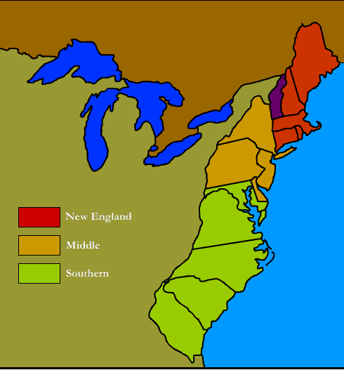
Map of the 13 Colonies

Slide 8
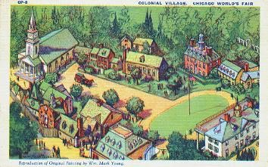
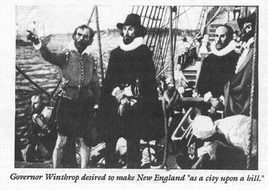
Notes
The Massachusetts Bay Colony
Puritans (strict religion) came from England and built a colony. They called it MBC.
The puritans wanted their colony to be a model for other English settlers.

Slide 9
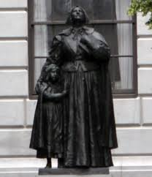
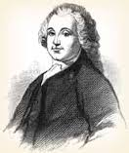
Notes
Roger Williams and Anne Hutchinson were kicked out of MBC for disagreeing with the Puritans and formed Rhode Island.
Others left to form Connecticut for better farmland.

Slide 10
Brain Break
https://www.gonoodle.com/dashboard

Slide 11
Recap
The point of today’s lesson was so you understand that people left their past homes to form new colonies.
With your SPARK Partner
Take a notecard
Use the sentence below and fill in the blanks with examples from today…
Be ready to show me your notecard, and your notes from class today as you go do project work time.

Slide 12
SPARK Partner Activity
Copy the sentence and fill in the blank three times.
____ left ______ because ______ to form _____.
Mr. Button left IJ Holton because he hated kids to form the state of Buttonston.

Slide 13
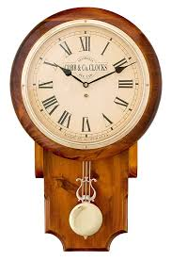
Work Time

Slide 14
Today
You’ll learn some more information about the NEW ENGLAND COLONIES.
Objectives
The learner will understand that new colonies were often created because people were kicked out or LEFT their former place.
I’ll take some notes on the New England Colonies. I’ll summarize the cause and effects of the Puritans and the Massachusetts Bay Colony.
Vocabulary:
Puritans
MBC
Model
Settlers
Rhode Island
Connecticut

