Slide 1
Geography of the 13 Colonies
Day 2

Slide 2
Announcements
Grades are done and updated. New Good Grades Challenge numbers….nice job!
STEAM Expo on Friday – no regular classes
Mr. Button gone on Thursday morning
HEAT forms due on Wednesday
Clubs that are close, but will be cancelled….
Dance
Scratch
Basketball
Scrapbooking

Slide 3
Unit Plan
Monday | Tuesday | Wednesday | Thursday | Friday
23 Physical Characteristics | 24 Effects of characteristics | 25 Human-made characteristics and Effects Test will be distributed. Finish them by Friday. | 26 (Mr. Button gone) Mostly a work day | 27 STEAM Expo – No classes
2 Projects Due | 3 | 4 | 5 | 6

Slide 4
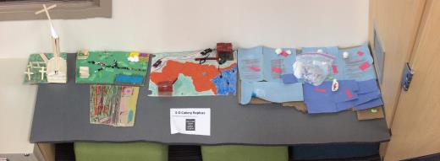
Housekeeping
Please take home your AMAZING 13 colonies 3D replicas.

Slide 5
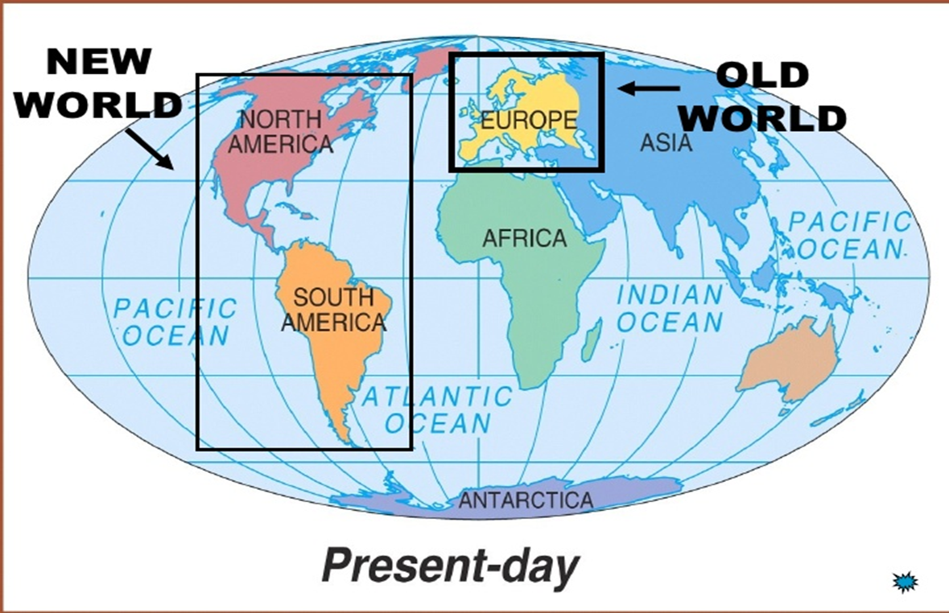
Review

Slide 6
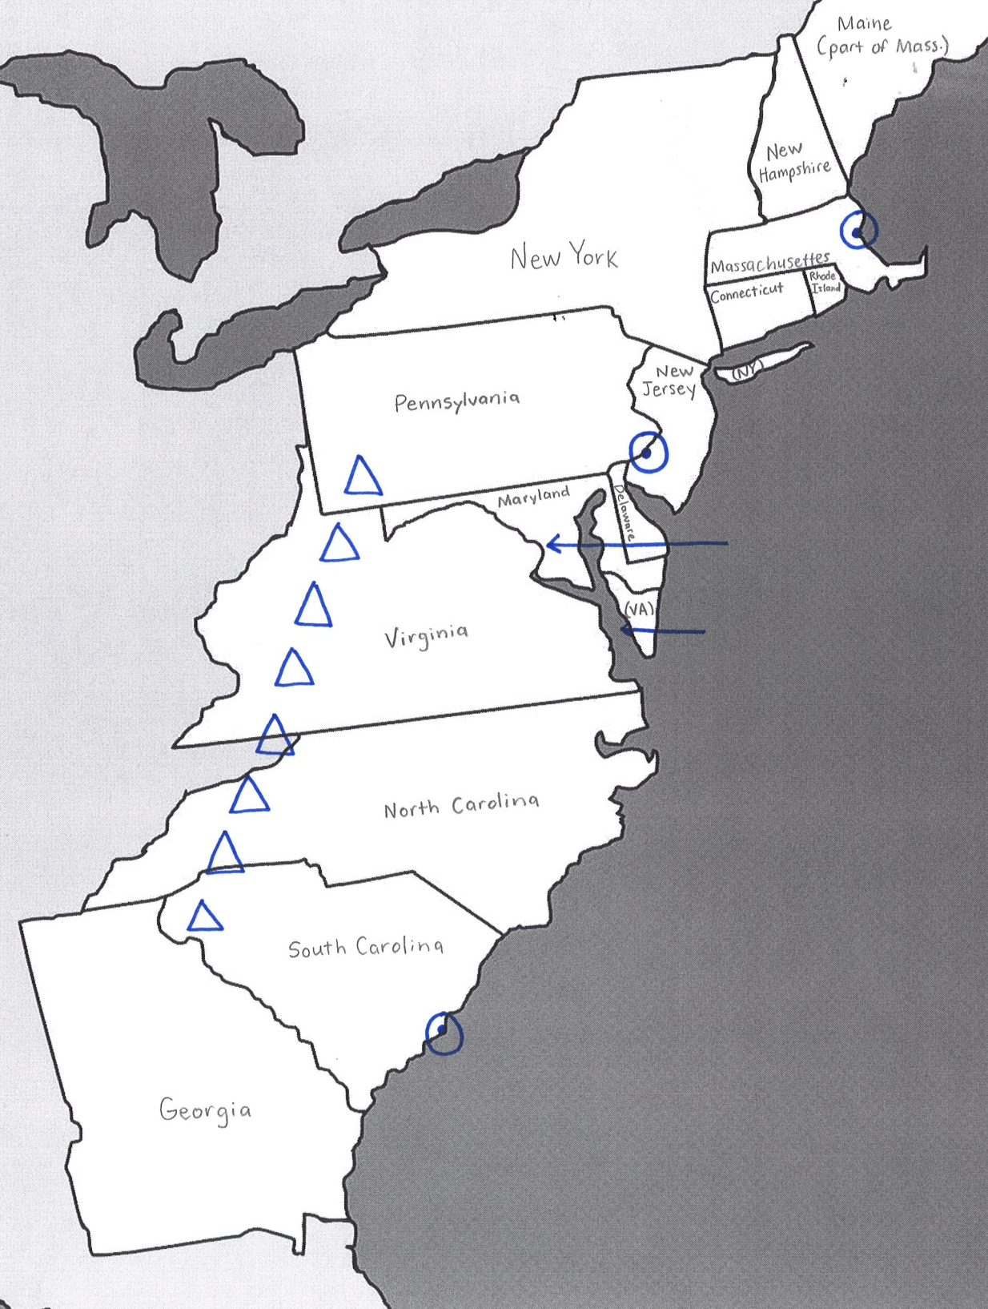
Review
What is a physical characteristic?
What is a human characteristic?
Can you identify these geographic features?

Slide 7
Review
With your STEAM Partner…
1. What were the landforms around the 13 colonies?
2. What were the major cities?
3. What were the major bodies of water?

Slide 8
Today…
You’ll take some notes on how the physical characteristics of the 13 colonies AFFECTED the colonists.
You’ll get project work time.
Objectives
The learner will understand how the Appalachian Mountains and the bodies of water affected the colonists.
I will take notes on how the physical characteristics of the New World affected the colonists. With a partner, I will discuss these questions?
How did the Appalachian Mountains affect the colonists?
How did climate affect the colonists?
How did the Atlantic Ocean, Chesapeake Bay and rivers affect the colonists?

Slide 9
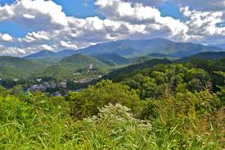
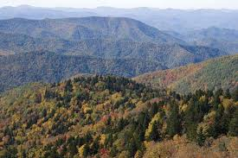
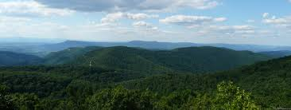
Notes
Physical Characteristic | Effect on the Colonies
Landforms Appalachian Mountains | The Appalachian Mountains were difficult to see past, and travel over. This created what was called a frontier, the land on the other side of the mountains. Because of this, most of the colonists stuck close to the east coast. (page 225)

Slide 10
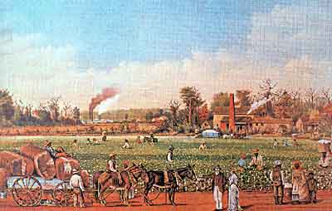
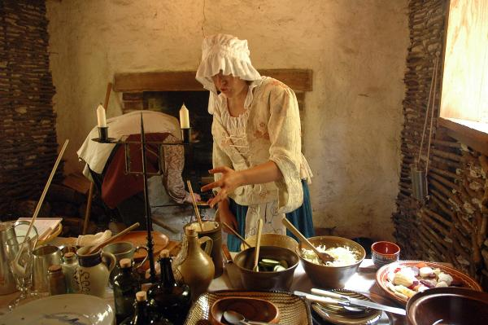
Notes
Physical Characteristic | Effect on the Colonies
Climates New England: Cold Winters, Hot summers South: Warm and Humid | Climates GREATLY affected the colonies. The people of the northern colonies had to find ways besides farming to make money (since they couldn’t farm all year long) The northern colonies also had to learn how to store and save food during the winter. The southern colonies COULD farm all year long, so they relied mostly on agriculture as their source of income. This is also why they created plantations.

Slide 12
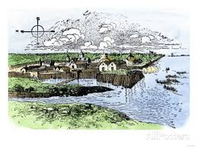
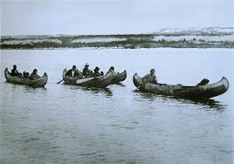
Notes
Physical Characteristic | Effect on the Colonies
Bodies of Water Rivers Atlantic Ocean Chesapeake Bay | Transportation along rivers. The passage to Europe. It was a dangerous and long voyage. Fertile Soil Transportation Good Fishing

Slide 13
Brain Break
https://www.gonoodle.com/dashboard

Slide 14
Review
With your STEAM partner, answer these questions…
How did the Appalachian Mountains affect the colonists?
How did climate affect the colonists?
How did the Chesapeake Bay and rivers affect the colonists?

Slide 15
Today…
You’ll take some notes on how the physical characteristics of the 13 colonies AFFECTED the colonists.
You’ll get project work time.
Objectives
The learner will understand how the Appalachian Mountains and the bodies of water affected the colonists.
I will take notes on how the physical characteristics of the New World affected the colonists. With a partner, I will discuss these questions?
How did the Appalachian Mountains affect the colonists?
How did climate affect the colonists?
How did the Atlantic Ocean, Chesapeake Bay and rivers affect the colonists?

Slide 16
Work Time
What should we remember when using work time?

