Slide 1
Geography of the 13 Colonies
Day 3

Slide 2
Announcements
Grades are done and updated. New Good Grades Challenge numbers….nice job!
STEAM Expo on Friday – no regular classes
If your parents come at 2:30….you can go home!
Mr. Button gone on Thursday morning

Slide 3
Unit Plan
Monday | Tuesday | Wednesday | Thursday | Friday
23 Physical Characteristics | 24 Effects of characteristics | 25 Human-made characteristics and Effects Test will be distributed. Finish them by Friday. | 26 (Mr. Button gone) Mostly a work day | 27 STEAM Expo – No classes Tests Due
2 Projects Due | 3 | 4 | 5 | 6

Slide 4
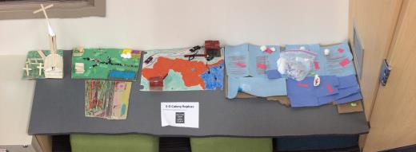
Housekeeping
Please take home your AMAZING 13 colonies 3D replicas.

Slide 5
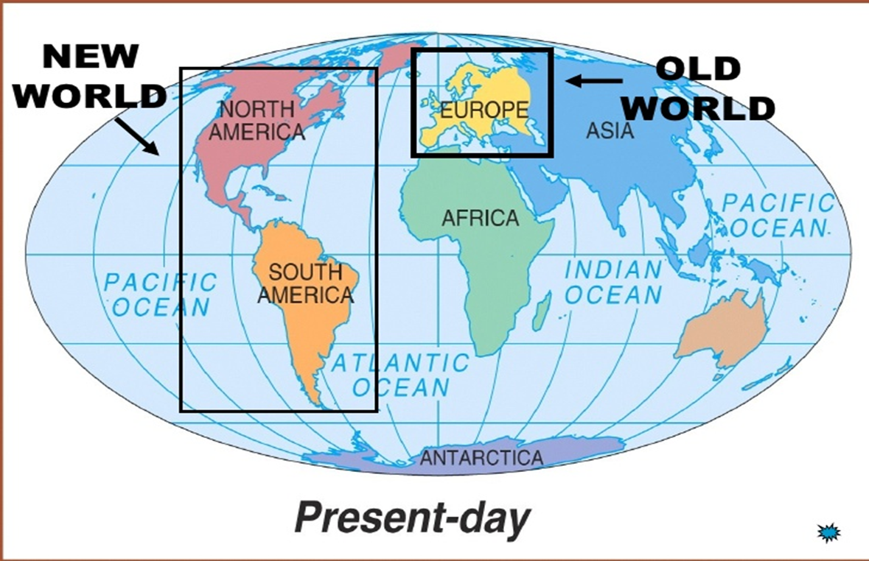
Review

Slide 6
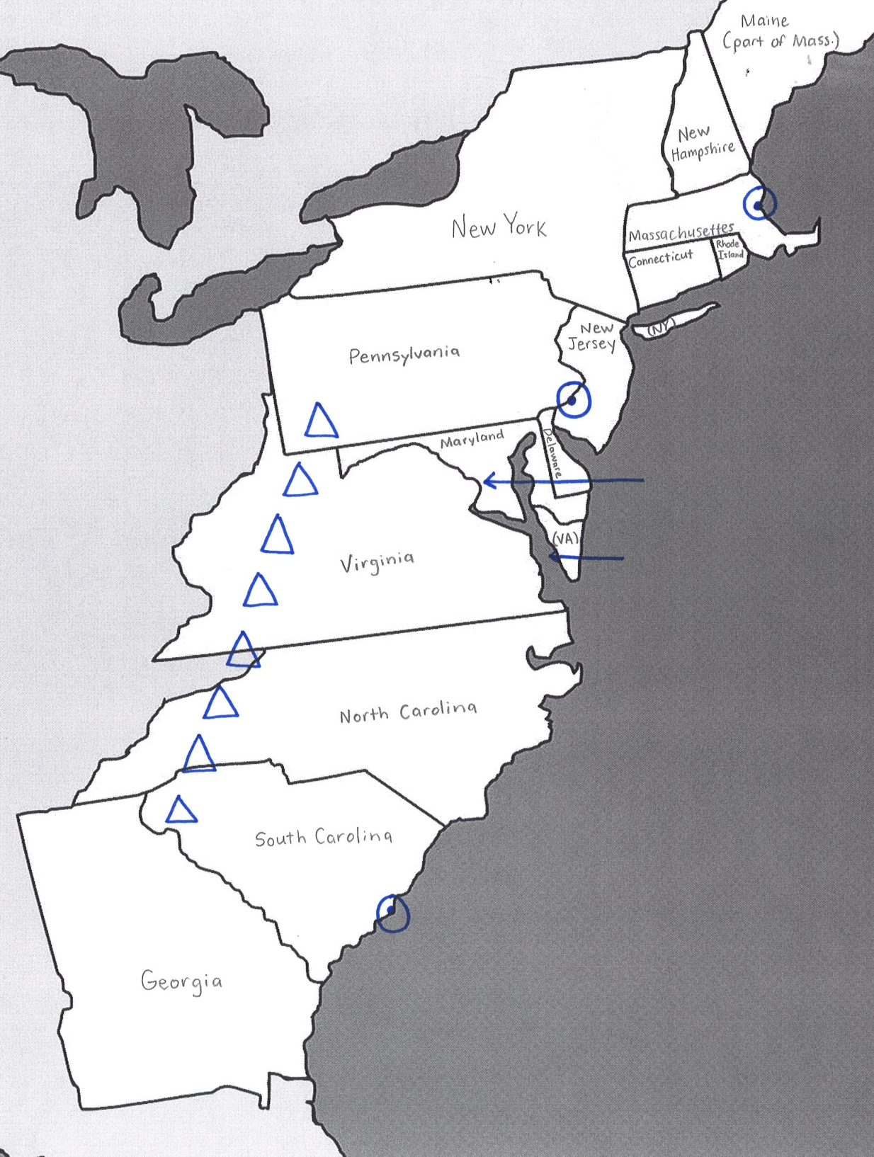
Review
With your STEAM Partner…
1. What were the landforms around the 13 colonies?
2. What were the major cities?
3. What were the major bodies of water?

Slide 7
Review
With your STEAM Partner…
1. How did the Appalachian Mountains affect the colonists?
2. How did colonists use rivers and the Chesapeake Bay?
3. How did climate affect the colonists?

Slide 8
Tests – Due Friday
Geography of 13 Colonies Test - 0.docx
Geography of 13 Colonies Test - 1.docx
Geography of 13 Colonies Test - 2.docx
Geography of 13 Colonies Test - 3.docx
Geography of 13 Colonies Test - 4.docx
Geography of 13 Colonies Test - 5.docx

Slide 9
Brain Break
https://www.gonoodle.com/dashboard

Slide 10
Today…
You’ll take some notes on the human characteristics of the 13 colonies.
You’ll answer some questions about these characteristics.
Objectives
The learner will list the human characteristics of the 13 colonies and draw some conclusions about these characteristics.
I will take list the human characteristics on my note sheet. I will work with a partner to answer a THINKING question about each characteristic.

Slide 11
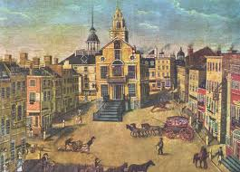
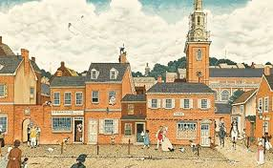
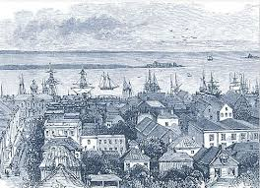
Notes
Human-Made Characteristic | Cause
Major Cities Boston Philadelphia Charles Town | Why were colonists eager to move to cities?

Slide 12
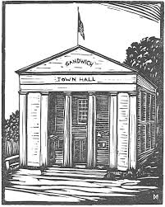
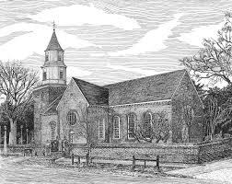
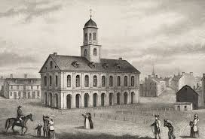
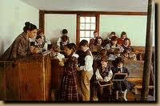
Notes
Human-Made Characteristic | Cause
Structures Town Halls Churches Schools Faneuil Hall – Boston | What was the purpose in building these structures?

Slide 13
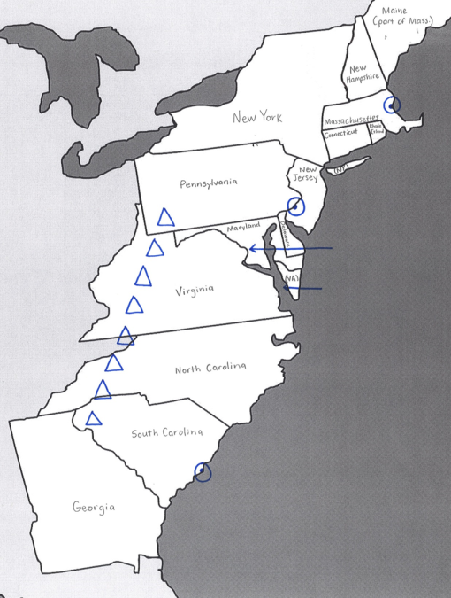
Notes
Human-Made Characteristic | Cause
Boundaries Colony Boundaries Boundaries with Natives Country Boundaries | Why did the colonists think it was necessary to create these boundaries?

Slide 14
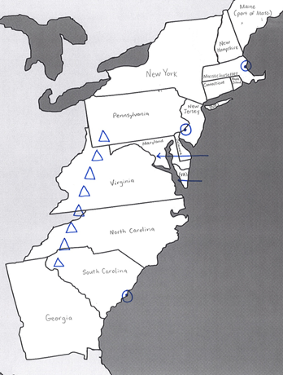
Notes
Human-Made Characteristic | Cause
Populations Virginia Massachusetts Maryland …… Last – Georgia | What was the cause of the population boom in some colonies but not others?

Slide 15
Review
With your STEAM partner, answer these questions…
What caused major colonial cities to form?
What caused the colonists to build structures?
What caused colonists to create boundaries?
What was the cause of the population increase?

Slide 16
Today…
You’ll take some notes on the human characteristics of the 13 colonies.
You’ll answer some questions about these characteristics.
Objectives
The learner will list the human characteristics of the 13 colonies and draw some conclusions about these characteristics.
I will take list the human characteristics on my note sheet. I will work with a partner to answer a THINKING question about each characteristic.

Slide 17
Work Time
What should we remember when using work time?

