Slide 1
Mindset

Slide 2
What is it?
A way of thinking about LEARNING and INTELLIGENCE and CHALLENGES.

Slide 3
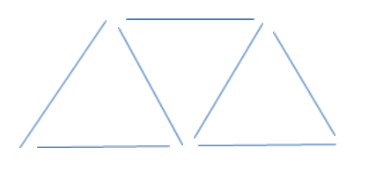
Challenge
Use 7 sticks and make this design.
MOVE 2 STICKS TO MAKE 2 TRIANGLES.
You must move only 2 and you cannot remove any sticks.
You have 7 minutes.
If you succeed, cover your design and show Mr. Button.

Slide 4
Discuss
So, how did you feel before you started this activity? What were you saying to yourself?
What did you feel and say to yourself during the activity?
How did you feel and speak to yourself after the activity
What I saw
Body Language
Facial Features
Words

Slide 5
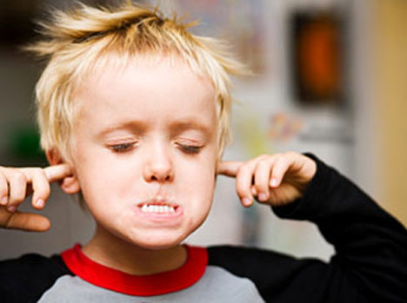
Fixed Mindset
In a fixed mindset, people believe their basic qualities, like their intelligence or talent, are simply fixed traits. They spend their time documenting their intelligence or talent instead of developing them. They also believe that talent alone creates success—without effort. They’re wrong.

Slide 6
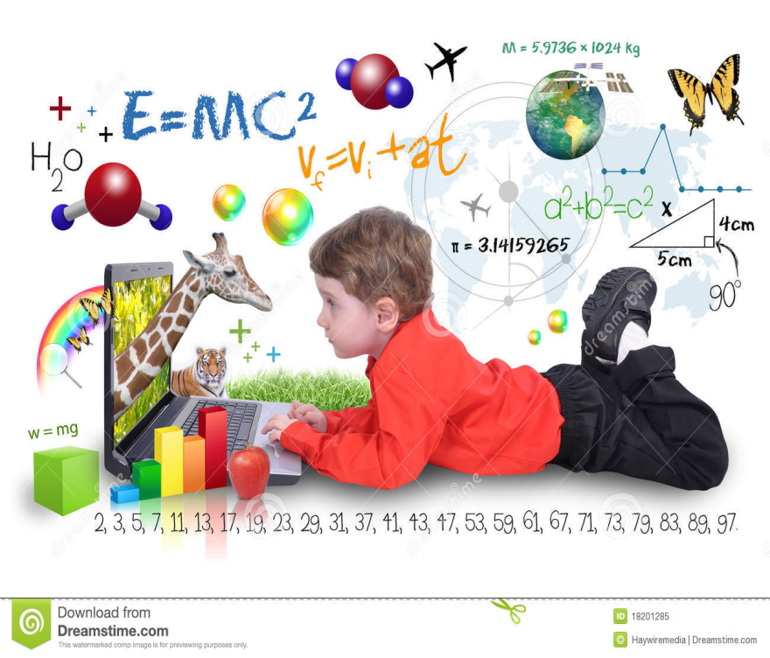
Growth Mindset
In a growth mindset, people believe that their most basic abilities can be developed through dedication and hard work—brains and talent are just the starting point. This view creates a love of learning and a resilience that is essential for great accomplishment. Virtually all great people have had these qualities.

Slide 7
Famous Failures
U:\Holton 2014-2015\Week 15\Famous Failures.mp4

