Slide 1
Social Studies
September 29, 2014

Slide 2
Housekeeping
Tests Returned

Slide 3
Today
Student News
Writing
Bathroom Break
Objectives
The learner will share what he/she remembers about PN’s. The learner will plan his/her writing.
I will talk with my partner about the things I remember about Personal Narratives. I will plan my PN by filling out two graphic organizers. I will hear and read examples PN’s.

Slide 4
Tonight’s Homework
Complete both sides of the planning worksheet if you don’t finish in class today.

Slide 5
Review
On Friday, we talked about what a Personal Narrative is.
We read the Example “Alexander and the Terrible…”
With your SPARK Partner:
Rally Robin
What are the things that all Personal Narratives have?
Blue Starts
Your homework was to choose one seed idea to begin writing about today.

Slide 6
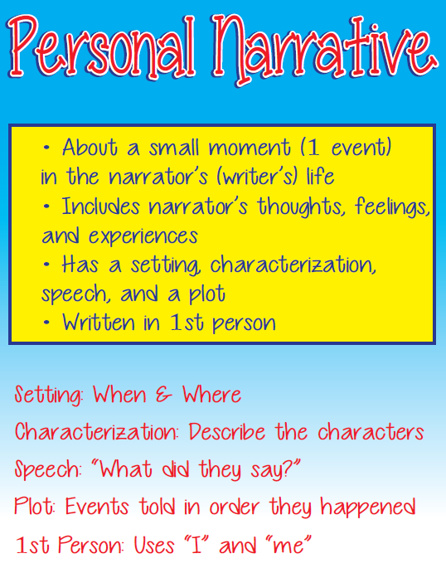

Slide 7
Today’s Lesson – Plan
Before a writer even begins writing his/her story, he/she makes a PLAN.
All good writers plan out what they will write.
In their heads
On paper
On the computer
Talking aloud
Today, I’ll show you how to plan your PN by using a tool called a web.
The trick is to choose a seed that you can tell A LOT about.

Slide 8
Using the Web
SMART File

Slide 9
Your Turn
Your choice
Paper Copy
Electronic Copy
TIP: If you don’t take your computer home at night, take a paper copy.

Slide 10
Putting it in Order
Now you will think about the main
events in your small moment and you’ll put them in order
because personal narratives are usually told in chronological
order.

Slide 11
Using the Graphic Organizer
SMART File

Slide 12
Your Turn

Slide 13
Student Examples
http://teachersites.schoolworld.com/webpages/hultenius/writing.cfm?subpage=1212921

Slide 14
Homework
If you didn’t get done, this is now homework.
Make sure it goes in your agenda
Put it in your homework folder

