Slide 1
Early Americans
Day 1

Slide 2
Housekeeping / Announcements
Shortened schedule today.
Assessments returned during student news.
I need them back.

Slide 3
Review
Last week, we finished up our unit on the Bill of Rights.
We took an assessment and presented posters on Friday.

Slide 4
Today
Student News
Start a new unit – Early Americans
Aztec Civilization
Objectives
The learner will talk with a partner about inferences and background knowledge regarding pictures.
I’ll make a guess about what some pictures mean that Mr. Button shows me. I’ll share my thoughts with a partner and the class.

Slide 5
Tonight’s Homework
None!!!

Slide 6
Think about this!
Tell your STEAM Partner.
What language do we speak in America?
Was it always like that?
What language do we speak in Mexico?
Was it always like that?

Slide 7
Keep thinking…
With your SPARK Partner
Look at the following pictures.
Tell your partner, and answer on Socrative:
Have you seen something like this before?
What do you think it is?
What clues make you think that?
(your answers don’t have to be RIGHT, but you have to tell your partner SOMETHING)
You’ll get a few seconds for each picture. Be ready to share.

Slide 8
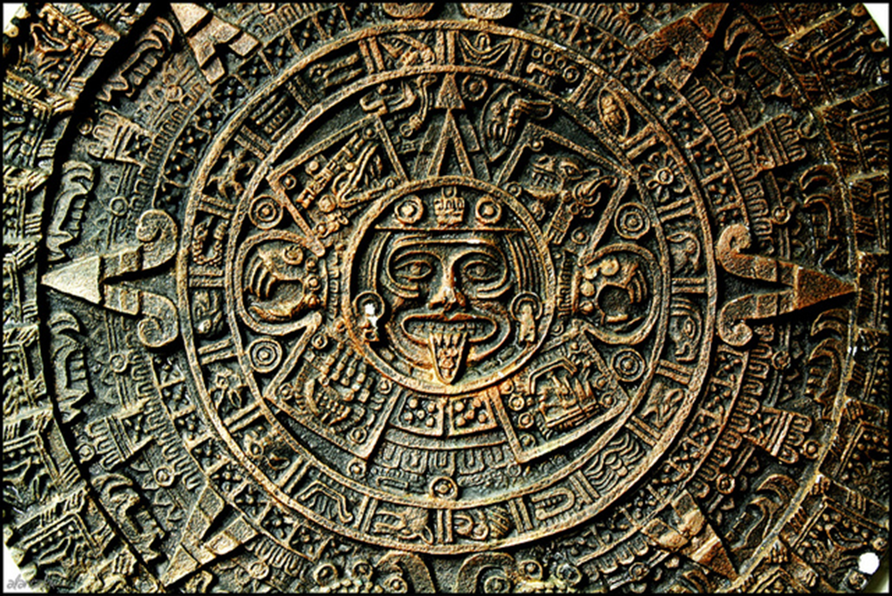
Have you seen something like this before?
What do you think it is?
What clues make you think that?

Slide 9
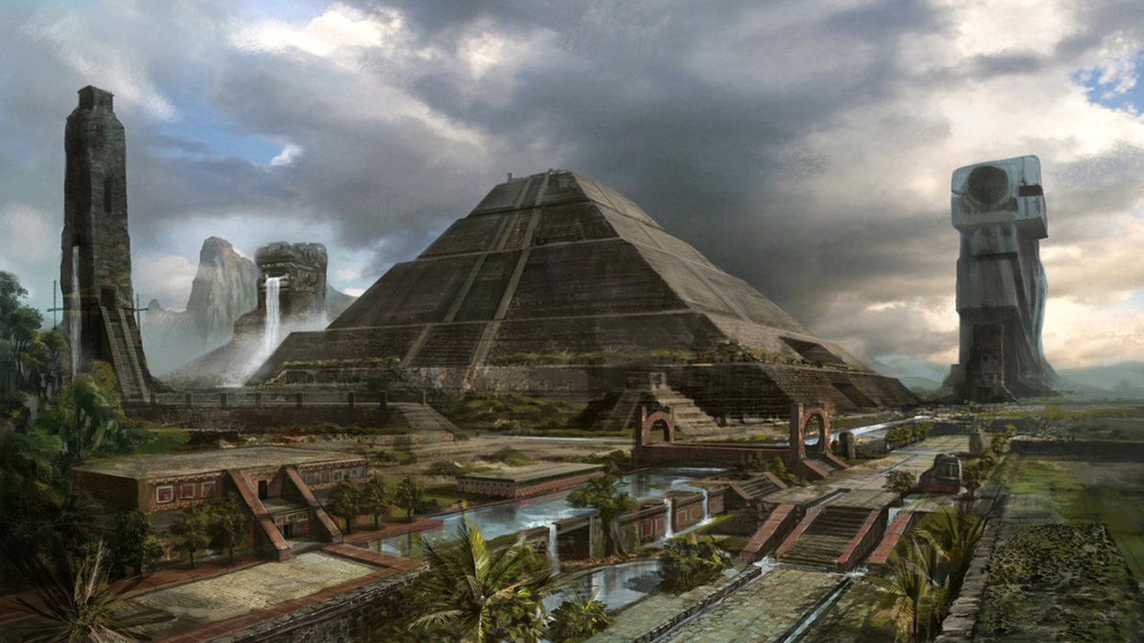
Have you seen something like this before?
What do you think it is?
What clues make you think that?

Slide 10
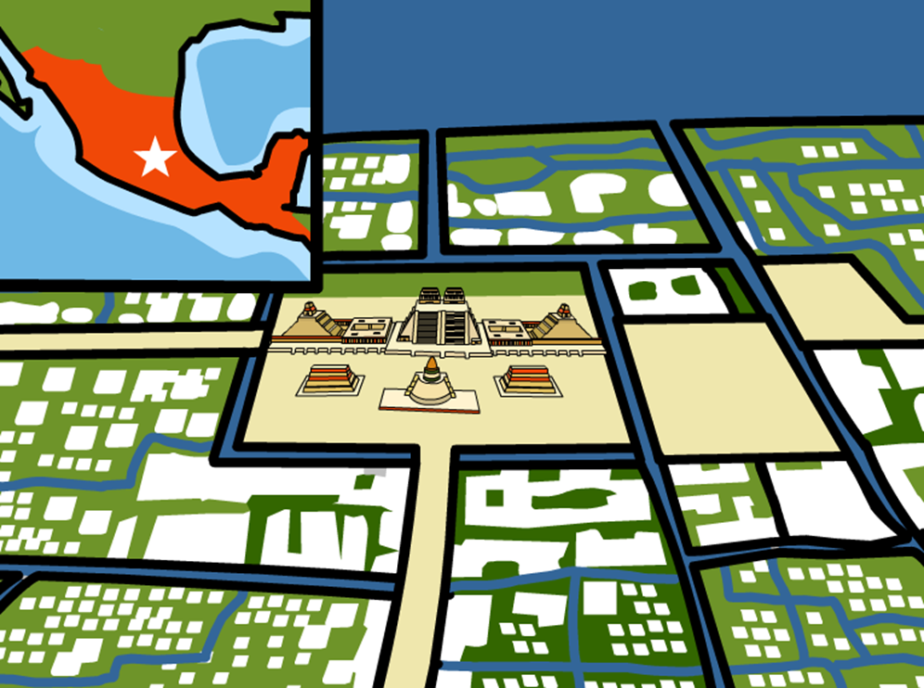
This Week…
We’ll learn about the people that lived in Mexico and the US before the languages were changed to Spanish and English.

Slide 11
Timeline
1492
Columbus lands in San Salvador, Bahamas
1776
Declaration of Independence signed
Now
Before that?

Slide 12
Recap
Homework
None. ☺
Objectives
The learner will talk with a partner about inferences and background knowledge regarding pictures.
I’ll make a guess about what some pictures mean that Mr. Button shows me. I’ll share my thoughts with a partner and the class.

Slide 13
Time?

