Slide 1
Reading
Have a seat at your desk for a SPARK CARD DRAWING and then the NAME CHALLENGE

Slide 2
What we’ll do in Reading Today…
Talk about reading assessments next week and TRUST.
Practice Read to Self in the FTLA
Fill out agendas at 12:00
Go to lunch (once your agenda is complete).

Slide 3
Book Shopping Today
Madison, Cole, Blake, Francisco, Berenice, Ramiro, Andrew
Return the books in your book box.
Put them back in the correct place. Keep any books you’re still working on.
Choose new books.
Go tell the next person it’s time to book shop.

Slide 4
Assessments Next Week

Slide 5
Assessments You’ll Take
DIBELS
Spelling
MONDO Reading Cards

Slide 6
Why do we take them?
So I can learn about you as a reader
So YOU can know your strengths

Slide 7
I have to be able to trust you
While I’m assessing, I won’t be able to watch you read to self.
Can I trust you to do your job?
What should you do if you find yourself not following one of the Top 5?
Ignoring Distraction
Reading the Whole Time
Choosing a good spot?

Slide 8
Ignoring – a muscle

Slide 9
Read to Self Practice!!

Slide 10
Agendas
Once your agenda is filled, ask an adult to check, then you may go to lunch!!

Slide 11
Welcome Back!
Have a seat and we’ll have a SPARK Card drawing!

Slide 12
This afternoon…
Book Shopping
Reading Café
About Me Wall – Mr. Button
Read to Self practice

Slide 13
Book Shopping Today
Madison, Cole, Blake, Francisco, Berenice, Ramiro, Andrew
Return the books in your book box.
Put them back in the correct place. Keep any books you’re still working on.
Choose new books.
Go tell the next person it’s time to book shop.

Slide 14
Introducing CAFÉ
Strategies for Reading

Slide 15
Good Readers
There are many things that good readers do.
We’ll be learning and practicing these things this year.
You may already know some of the things that good readers do.
Turn and Talk
What are the things that good readers do?

Slide 16
The CAFÉ
We can display these good reading habits on a board called a CAFÉ
Think about going to a restaurant…
Not sure what to get, what do you look at?
Our reading CAFÉ is like a menu of reading strategies

Slide 17
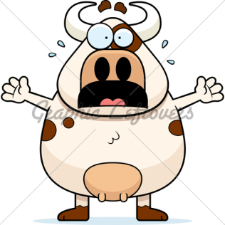
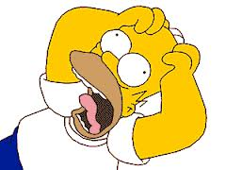
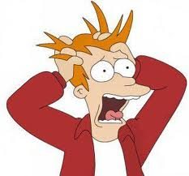
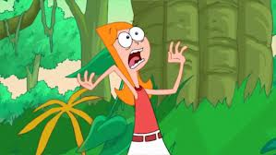
Strategies
Let’s say you’re reading and something goes wrong with your reading. What do you do?
This?

Slide 18
Strategies
No! You would use a strategy!
A strategy is something that helps you read better by telling your brain exactly what to fix.
Some reading strategies could be:
Use the pictures as clues
Make an inference
Back up and reread
Replace the word with one that you know

Slide 19
The CAFÉ
The Café is the menu where we keep all of our strategies
We put them in different categories depending on what we need help with
C – Comprehension (I understand what I read)
A – Accuracy (I can read the words correctly)
F – Fluency (I can read smoothly with few errors and I understand what I read)
E – Expand Vocabulary (I know, find, and use interesting words)

Slide 20
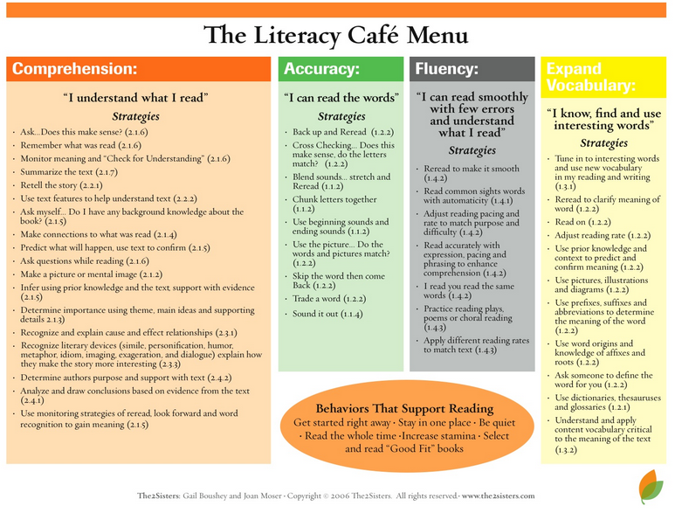

Slide 21
The rest of the year…
We’ll learn more and more reading strategies throughout the year
In whole-group reading
In small-group reading
Reading 1-on-1 with me
We’ll have a class CAFÉ, and you’ll each get your own
As we discover new strategies, you’ll add them to your own CAFÉ or to our classroom CAFÉ

Slide 22
About Me Wall
Read the Letter
My stuff

