Slide 1
Social Studies
September 17, 2014
Find your seat.
Tell your SPARK Partner
Your name
If you could meet any famous person, who would you meet?
Why would you meet that person?

Slide 2
Announcements / Housekeeping
I am working on grading your stuff and will have everything entered tonight…hopefully. ☺
Peer Power Partner permission forms are due tomorrow.

Slide 3
Agenda
Today we will…
Take more time to learn about the branches of government.
Objectives
The learner will watch a video on the branches of government and fill out a graphic organizer with a partner. The learner will check his/her work by filling out the same GO with the class.
I will watch or read the resources Mr. Button has for me. Then, with a partner, I will fill out the worksheet on the Branches of Government. As a class, I will take notes on the branches of government.

Slide 4
Mystery Student

Slide 5
Homework
None today… unless you want to do more research on the three branches by yourself.
There will be a test covering this stuff on MONDAY!
Tomorrow, I’ll teach you how to study.

Slide 6
With your STEAM Partner
Open your OneNote.
Go to the Branches of Government pages.
Share with your partner any answers you found yesterday. Or, if you didn’t answer any questions, talk about which resource you used yesterday.
Green goes first.
I’ll give you a worksheet while you’re doing that.

Slide 7
Resources Together
While we watch or read these resources, take notes on your worksheet. Then, you’ll share your notes with your partner.
http://www.brainpopjr.com/socialstudies/government/branchesofgovernment/
http://www.congressforkids.net/Constitution_threebranches.htm

Slide 8
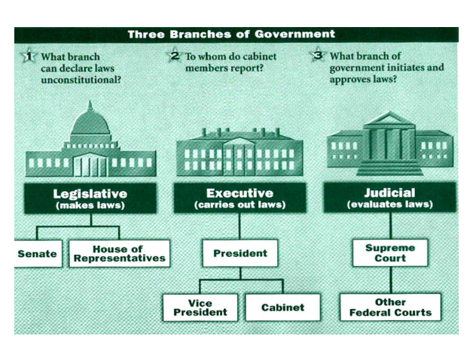

Slide 9
Talk with your SPARK Partner
Share what you wrote on your note page.
Discuss if you think your partner’s information is correct or incorrect.
Say This:
Partner 1: In this box, I wrote ________________.
Partner 2: Agree? Disagree?
.
Then switch roles.
I agree. That’s what I wrote too. | I wrote something else. Here what I wrote.

Slide 10
Now let’s fill it out together.
Watch and see what I write.
Follow along and write what I write.

Slide 11
Tomorrow
We’ll make study cards for your test on Monday. You’ll have more time to work on your OneNote pages.
Objectives
The learner will watch a video on the branches of government and fill out a graphic organizer with a partner. The learner will check his/her work by filling out the same GO with the class.
I will watch or read the resources Mr. Button has for me. Then, with a partner, I will fill out the worksheet on the Branches of Government. As a class, I will take notes on the branches of government.

