Slide 1
Atlas Skills
Tell your SPARK partner…
Your name and a mythical creature you would like to have for a pet.
Tell your STEAM partner….
Your name and which state you’d most like to live in and why. (you can’t choose MN!)
Thursday, December 4

Slide 2
Housekeeping / Announcements
Geography Bee yesterday
Mrs. Irvin is gone today and tomorrow
OLPA Make-Up Testing

Slide 3
Review
Yesterday, we used the atlases and learned about the US states.

Slide 4
Today
Atlas Project – Map Drawing
Work Time
Bathroom Break
Objectives
The learner hear information about map basics (TODALS). The learner will explain to a partner each of the map basics. The learner will begin working on a map assignment.
I’ll listen to Mr. Button as he tells me the important things that are on every map (we call it TODALS). I’ll work with a partner to find each of the TODALS on a map and explain what each is. I’ll start working on drawing my own map.

Slide 5
MAP basics
T
O
D
A
L
S

Slide 6
MAP basics
T – Title
O – Orientation
D – Date
A – Author
L – Legend
S – Scale

Slide 7
Examples
Find the TODALS.
Explain what each is.

Slide 8
T O D A L S

Slide 9
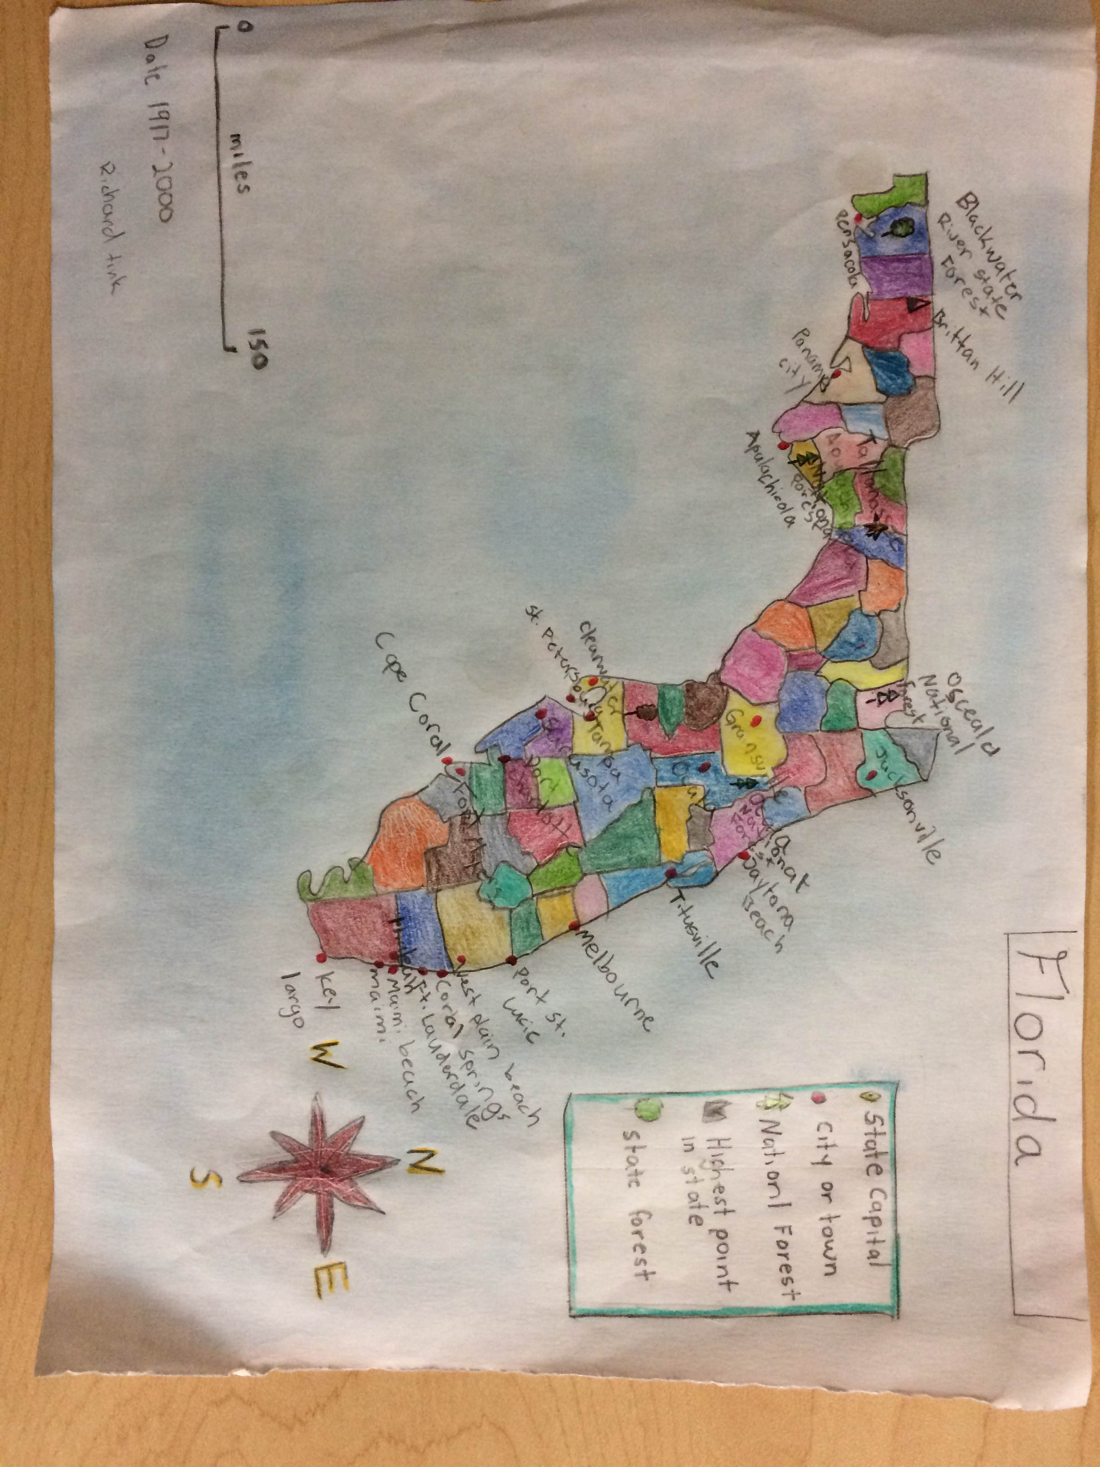
T O D A L S

Slide 10
Assignment
Choose a state or continent from our studies this week.
On a blank sheet of paper, draw a map of that location.
Your map must include:
T – a title
O – orientation (which way is north, south, etc)
D – date that the map was drawn
A – author (who drew the map)
L – legend (what the different symbols on the map mean)
S – scale (what one inch on the map represents in feet)
Hand it in to Mr. Button

Slide 11
Work time expectations
I will work the whole time.
I will work with a level 2 voice.
I will not disturb others from working.
This assignment is work 15 ASSESSMENT points, to see if you understand TODALS and can produce 5th-grade work.

Slide 12
Today
Atlas Project – Map Drawing
Work Time
Bathroom Break
Objectives
The learner hear information about map basics (TODALS). The learner will explain to a partner each of the map basics. The learner will begin working on a map assignment.
I’ll listen to Mr. Button as he tells me the important things that are on every map (we call it TODALS). I’ll work with a partner to find each of the TODALS on a map and explain what each is. I’ll start working on drawing my own map.

