Slide 1
Social Studies

Slide 2
Housekeeping / Announcements
Unity Week
https://www.youtube.com/watch?v=7obWRSThBms

Slide 3
Review
Yesterday, you PRINTED AND SHARED your personal narratives!!!!!! YAY!!!!

Slide 4
Today
Student News
Bill of Rights
Bathroom Break
Objectives
The learner will be presented with background information about the Bill of Rights. The learner will think about his/her background knowledge regarding that topic.
I will think about today’s 2 BIG questions as Mr. Button talks about the Bill of Rights and I watch videos on it. I will answer the 2 BIG questions with a partner, and then write them on the computer and send them to Mr. Button.

Slide 5
Tonight’s Homework
None!

Slide 6
Have you ever heard…
With your SPARK partner
Have you ever heard someone say this?
What do you think it means?
“It’s a free country, isn’t it?”
“Freedom of Speech”
“Right to Bear Arms”
Blue: I am so impressed by you. Green: We are a great team!

Slide 8
Here’s Some Background
Watch these videos and be ready to answer the following questions.
What is the Bill of Rights?
Why is the Bill of Rights important?
http://www.youtube.com/watch?v=yYEfLm5dLMQ
http://www.brainpop.com/socialstudies/usgovernmentandlaw/billofrights/ (username: vue1 password: vue1)

Slide 9
More Info
The Bill of Rights is a list of rights of people in the United States. The Bill of Rights includes
Freedom of Speech
Freedom of the Press
Freedom of Religion
The right to bear arms
No soldiers can stay at people’s homes in times of peace.
The right to a public trial with a jury

Slide 10
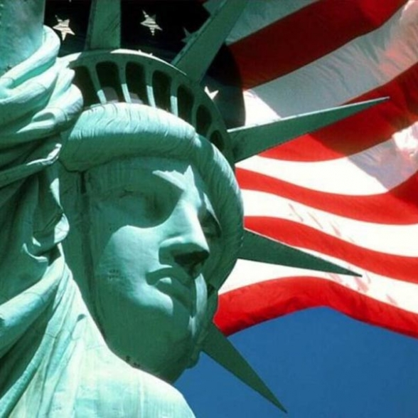
Why?
The Bill of Rights was created so people in the US had more FREEDOM than other countries in the world.

Slide 11
Review
After watching those two videos, can you answer these questions?
What is the Bill of Rights?
Why is the Bill of Rights important?
Mix, Pair, Share
Music
Partners
Talk
Share out with popsicle sticks

Slide 12
Socrative
beta.socrative.com
button158

Slide 13
Recap
Homework
None
Objectives
The learner will be presented with background information about the Bill of Rights. The learner will think about his/her background knowledge regarding that topic.
I will think about today’s 2 BIG questions as Mr. Button talks about the Bill of Rights and I watch videos on it. I will answer the 2 BIG questions with a partner, and then write them on the computer and send them to Mr. Button.

