Slide 1
Explorers – Day 3
Get to meet your new neighbor.
Tell you STEAM Partner….
Your name and your family’s favorite place to eat.
Tell you SPARK Partner…
Your name and your favorite holiday.

Slide 2
Housekeeping / Announcements
5th grade will see the musical tomorrow.
High of 23 today? You’re still going outside for walking path!
Get organized – clean out your Returned Assessments pocket. Take them home or throw them away.

Slide 3
Review
Yesterday, you learned about the Explorers Project. You chose your group of 2 or 3 and chose your explorer. Some of you started researching.

Slide 4
Today
Student News
Explorers Project Work Time
Exit Slip
What have you learned about your group’s explorer?
What were some ways that you and your group had good COLLABORATION today?
The learner will research an early European explorer and summarize the most important details on a PowerPoint. The learner will discuss his/her explorer with a partner.
I will work with my group to research my explorer. With my group, we’ll talk about the things that we thought were the most important about our explorer and decide what information we should put in our PowerPoint. We will use good collaboration skills.

Slide 5
Collaboration Skills
Be a good listener
Agree peacefully
“I’m not sure about that”
Rock Paper Scissors
Give Everyone a Job
PowerPoint maker
Note Taker

Slide 6
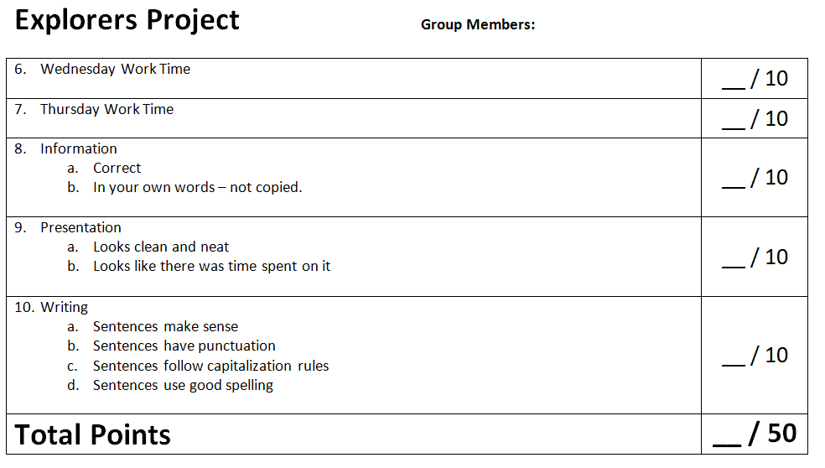
Explorers Project Rubric

Slide 7
Work Time
Decide on Tasks for group members.
Research and fill out note sheet.
Discuss the main information you want in the PPT.
Create the PowerPoint.
Answer the Socrative questions at __:08
beta.socrative.com
button158

Slide 8
Recap Today
Student News
Explorers Project Work Time
Exit Slip
What have you learned about your group’s explorer?
What were some ways that you and your group had good COLLABORATION today?
The learner will research an early European explorer and summarize the most important details on a PowerPoint. The learner will discuss his/her explorer with a partner.
I will work with my group to research my explorer. With my group, we’ll talk about the things that we thought were the most important about our explorer and decide what information we should put in our PowerPoint. We will use good collaboration skills.

